Slide 1
2017 Housing
Market Perspectives
Monterey County AOR
June 29, 2017
Leslie Appleton-Young, Chief Economist
lesliea@car.org

Slide 2


FREE 45-Hour Online CE Package in 2017
car.org/education/LicenseRenewal
Notes:
New C.A.R. Member Benefit - 45 hour online package to complete your license renewal requirement
FREE 45-hour packages include:
First time Salesperson
First time Broker
Subsequent Renewal Salesperson & Broker
Spanish Language Version
Meets all CalBRE Course requirements
Courses allow you to go at your own pace
Visit: car.org/education/licenserenewal

Slide 3



Slide 4


Slide 5

Notes:
Your mortgage resource to help with any of your mortgage, lending and financing issues and questions.

Slide 6

Overview
Economic Update
California Housing Market Outlook
Regional Housing Market Outlook
2017 Forecast

Slide 7
Post-Election Outlook

Slide 8
Full Disclosure
REALTOR® Party – Policy is viewed through the lens of Realtor business success & homeownership
Powerful alliance of REALTORS® and REALTOR® Associations working to protect and promote homeownership and property investment.
The REALTOR® Party speaks with one voice to advance candidates and public policies that build strong communities and promote a vibrant business environment.

Slide 9
Truth
Market/Politics/Rates/Policies/Regulations are not YOUR Destiny
There will be enough sales in 2017 for EVERYONE here to have a great year

Slide 10



Social Media & You

Slide 11
Do you plan to leave the country if…?

Slide 12
Economic Update

Slide 13




2017: Weak Start for Economic Growth but Job Market Remained Solid
1.4%
0.6%
GDP 2017-Q1
Consumption
2017-Q1
4.3%
1.6%
Unemployment
May 2017
Job Growth
May 2017

Slide 14
Slowest GDP growth since Q1 2016
2016: 1.6%; 2017 Q1: 1.4%
ANNUALLY
QUARTERLY
2009 Largest Annual Drop since 1946 (-2.8%)
SERIES: GDP
SOURCE: U.S. Bureau of Economic Analysis
Notes:
14
Weakness was primarily centered on a slower pace of consumer spending. Real consumer spending inched up just 0.6 percent in Q1, which was the weakest annualized pace growth since Q409. Milder-than-usual winter weather during the first two month of the year was the factor that kept economic growth below the norm. As such, consumers did not spend as much on utility services. On the other hand, business fixed investment posted a strong quarterly performance, up 11.9 percent.
The outlook for capital spending outside of the energy sector has improved now that the nearly two-year slide in industrial activity appears to have ended. Small business owners are more upbeat, and a rising number of business owners plan to increase capital spending. The shift in business attitudes is a potential potent tailwind and raises some upside bias to the forecast.
Business inventories fell 0.2 percent in April after rising 0.2 percent in March, marking the end of five months of modest gains. The total business inventory-to-sales ratio has remained at 1.37 for the past five months, suggesting inventories are roughly keeping pace with slower growing demand. One exception is auto dealers, where inventories fell 0.4 percent in April, perhaps signaling the start of a needed correction. Inventories will need to rebound solidly in May and June in order to provide a meaningful boost to Q2 GDP growth.
Business/consumer sentiment continues to suggest the weakness in Q1 was not the start of a new trend. On early signs of strengthening consumer, resilient BFI and residential construction activity, conditions suggest US GDP will rebound in Q2.

Slide 15
Job Market Tight: Unemployment Rates Lowest Since 2001
US 4.3% (May 2017) & CA 4.7% (May 2017)
SERIES: Unemployment Rate
SOURCE: U.S. Bureau of Labor Statistics, CA Employment Development Dept.
Notes:
Job growth in May= 138,000. Job gains occurred in health care and mining. The labor force participation rate declined by 0.2 percentage point
to 62.7 percent in May but has shown no clear trend over the past 12 months. Total nonfarm payroll employment increased by 138,000 in May, compared with an average monthly gain of 181,000 over the prior 12 months. Over the past 3 months, job gains have averaged 121,000 per month.
In May, employment in professional and business services continued to trend up (+38,000). The industry has added an average of 46,000 jobs per month thus far this year, in line with the average monthly job gain in 2016. Employment in food services and drinking places also continued to trend up in May (+30,000) and has grown by 267,000 over the past 12 months.
The average workweek for all employees on private nonfarm payrolls was unchanged at 34.4 hours in May. In manufacturing, the workweek also was unchanged at 40.7 hours. The current level of weekly hours in manufacturing is almost an all-time high, and there is no decline so far. That’s good news from Main Street. The logic that underlies this as a leading indicator is that in the face of a decline in sales, manufacturers first cut overtime hours and only later lay off workers. The alarm sounded by a decline in weekly hours precedes the recession by only two or three quarters.

Slide 16
CA Jobs Growing Slower Than the Nation for the First Time since Early 2012
CA 1.4% (05/17)
US 1.6% (05/17)
SERIES: Total Nonfarm Employment
SOURCE: U.S. Bureau of Labor Statistics, CA Employment Development Dept.
Notes:
California payrolls rose by 17,600 jobs in May, equaling the jobs cut in April. California has added an average of 11,920 jobs in the first five months of 2017, well below the comparable 35,000 jobs averaged last year.

Slide 17
Monterey Unemployment: 5.2%
May 2017: California 4.7%
SERIES: Unemployment Rate
SOURCE: CA Employment Development Division
Notes:
Source: http://www.labormarketinfo.edd.ca.gov/LMID/Employment_by_Industry_Data.html
Unemployment rate is seasonally adjusted at the state level, but not at the county level

Slide 18
Consumers Less Upbeat but Positive
Consumer Confidence: 117.9 (May 2017)
SERIES: Consumer Confidence
SOURCE: The Conference Board
Notes:
Consumers’ appraisal of current conditions held steady in May. Those saying business conditions are “good” edged down from 30.8 percent to 29.4 percent, but those saying business conditions are “bad” was unchanged at 13.7 percent. Consumers’ assessment of the labor market also remained positive. Those stating jobs are “plentiful” declined marginally from 30.3 percent to 29.9 percent, however, those claiming jobs are “hard to get” decreased from 19.4 percent to 18.2 percent.
Consumers were less optimistic about the short-term outlook in May. The percentage of consumers expecting business conditions to improve over the next six months decreased from 25.1 percent to 21.3 percent, however, those expecting business conditions to worsen declined marginally from 10.4 percent to 10.1 percent.
Consumers’ outlook for the labor market was mixed. The proportion expecting more jobs in the months ahead declined from 21.9 percent to 18.6 percent, but those anticipating fewer jobs decreased from 13.8 percent to 12.0 percent. The percentage of consumers expecting their incomes to increase edged up from 18.7 percent to 19.2 percent, but the proportion expecting a decrease also rose, from 7.6 percent to 8.7 percent.
Buying plans for automobiles, homes and major appliances all declined. While these data are notoriously volatile, all three series hit their lowest levels this year. This bears watching but runs counter to recent reports citing improving consumer finances.

Slide 19
Inflation Fell in May – Low Gas Prices
May 2017: All Items 1.9% YTY; Core +1.7% YTY
SERIES: Consumer Price Index
SOURCE: US Bureau of Labor Statistics
Notes:
“Core Inflation” is All Items Less Food and Energy
The CPI data is seasonally adjusted.
SOURCE:
Go to http://www.economy.com/freelunch/fl_dictionary.asp?m=34174038-A1EF-4C70-9374-59144B50A3F5&h=H0022000400040002&f=0&c=undefined
First choose "All Items." "Monthly" and "Yr/Yr%" series.
Then find "All items less food and energy" towards the bottom of the CPI list. Do the same as above.

Slide 20
Post-Election Uncertainty
Economic stimulus package/tax reform
  $550 billion over 10 years
  Plan requires significant private partnerships
  Higher budget deficits will lead to rising interest rates
Tax Reform
  Simplification
  Low Rates
  Cost: $6.2 trillion over 10 years
Notes:
The tax cut would also result in the decline in Federal revenue by $6.2 trillion over the first decade.
Including interest costs, it would amount to $7.2 trillion over the first decade and $20.9 trillion by 2036.
The loss in federal revenue would lead to significantly higher budget deficits, which could exert more upward pressure on inflation.
Rising interest rates likely

Slide 21
Tax Reform: Key Components Trump Proposal
  Reduction in tax rates: Individual 39.5% to 33%
  Drop from 7 tax brackets to 3 (12%, 25%, 33%)
  Corporate tax rate from 35% to15%
  Eliminate the federal estate and gift taxes
  Repeal personal exemptions
  Cap itemized deductions
  Increase Standard Deduction
  Border Adjustment Tax (BAT)

Slide 22
CA Household Growth Continues to Support Strong Housing Demand
SERIES: Annual Household Growth
SOURCE: CA Department of Finance

Slide 23
Post-Election Uncertainty
Dismantling Dodd-Frank
  Banks will loosen up lending standards
  Buyers could have more mortgage options
  Heighten risks of having another financial bubble
Reform of GSE’s
  Privatization or not?
  Rates higher with privatized GSE’s
Notes:
The tax cut would also result in the decline in Federal revenue by $6.2 trillion over the first decade.
Including interest costs, it would amount to $7.2 trillion over the first decade and $20.9 trillion by 2036.
The loss in federal revenue would lead to significantly higher budget deficits, which could exert more upward pressure on inflation.
Rising interest rates likely

Slide 24
Post-Election Uncertainty
Repeal/Replace Obamacare
Trade Policy
Immigration Policy/H1B Visa Program

Slide 25
Outlook for Rates

Slide 26
Mortgage Rates: Lowest since the Election
January 2010 – June 15, 2017
MONTHLY
WEEKLY
SERIES: 30Yr FRM, 5Yr ARM
SOURCE: Freddie Mac
Notes:
Monthly from 2009 to present, weekly for the past 8 weeks

Slide 27
The FED’s Rate Hike
June 14 - Quarter percentage point hike to a range between 1% to 1.25%
One more increase later this year; 3 total for 2017
Mortgage rates actually fell to the lowest level afterward, partly because of lower than expected inflation
The Fed acknowledged that the recent decline in inflation was held down by temporary factors
SOURCE: The Federal Reserve

Slide 28
The FED’s Portfolio Will Shrink
Federal Reserve announced plan to shrink its portfolio of bond
Fed has $4.5 trillion in assets, and has continued to reinvest the proceeds to maintain the portfolio’s size
Fed will reduce holdings by allowing up to $6 billion in treasury securities and $4 billion in mortgage bonds to roll off without reinvestment
The limit will rise to a maximum of $30 billion a month for Treasury securities and $20 billion a month for MBS
SOURCE: The Federal Reserve

Slide 29
What Will Happen When Mortgage Rates Increase?
Q1-2017 Median Price $496,620
20% Downpayment
MONTHLY MORTGAGE
Minimum Qualifying Income
INTEREST RATE
INTEREST RATE
SERIES: Housing Affordability Index
SOURCE: CALIFORNIA ASSOCIATION OF REALTORS®

Slide 30
Housing Affordability Index - CA
What Will Happen When Mortgage Rates Increase?
% OF HOUSEHOLDS THAT CAN BUY, ALL ELSE CONSTANT
Q1-2017 Median Price $496,620
20% Downpayment
INTEREST RATE
SERIES: Housing Affordability Index
SOURCE: CALIFORNIA ASSOCIATION OF REALTORS®

Slide 31
California Housing Market Outlook

Slide 32
Home Sales Steady: +3.4% YTD
California, May 2017 Sales: 430,060 Units, +3.4% YTD, +2.6% YTY
May-16: 419,000
May-17: 430,060
SERIES: Sales of Existing Single Family Homes
SOURCE: CALIFORNIA ASSOCIATION OF REALTORS®
*Sales are seasonally adjusted and annualized
Notes:
Peak:624,957 units in 2005
Valley:189,345 units in 1982
2012 annual sales up 4.3% from 2011
2011 annual sales up 1.4% from 2010
2010 annual sales down 12.3% from 2009
2009 annual sales up 24.5% from 2008
2008 annual sales up 30.4% from 2007
2007 annual sales down 33.4% from 2006
2006 annual sales down 23.8% from 2005
2005 annual sales up 0.8% from 2004
2004 annual sales up 3.8% from 2003
2003 annual sales up 7.6% from 2002
2002 annual sales up 14.1% from 2001
2001 annual sales down 4.7% from 2000 YTD
2000 annual sales up 1.4 from 1999
1999 sales up 7.3% over 1998
10/93: 41.0
Consumer Confidence
01/00: 148.6
03/03: 63.0
5/07: 128.4
2/09: 23.9

Slide 33
Imbalance between Supply and Demand Led to Upward Pressure on Prices
California, May 2017: $550,200, +2.3% MTM, +5.8% YTY
May-16: $519,930
May-17: $550,200
SERIES: Median Price of Existing Single Family Homes
SOURCE: CALIFORNIA ASSOCIATION OF REALTORS®

Slide 34
Peak vs. 6/16: Southern California
SERIES: Median Price of Existing Detached Homes
SOURCE: CALIFORNIA ASSOCIATION OF REALTORS®

Slide 35
Peak vs. 6/16 Median: Central Valley
SERIES: Median Price of Existing Detached Homes
SOURCE: CALIFORNIA ASSOCIATION OF REALTORS®

Slide 36
Peak vs. 6/16 Median: Bay Area
SERIES: Median Price of Existing Detached Homes
SOURCE: CALIFORNIA ASSOCIATION OF REALTORS®

Slide 37
Some areas already at all-time highs
County | Previous Peak | Apr-17 | Diff. (%)
California | 594,530 | 536,750 | -9.7%
San Mateo | 1,020,000 | 1,500,000 | 47.1%
San Francisco | 972,014 | 1,402,500 | 44.3%
Marin | 1,149,390 | 1,325,000 | 15.3%
Santa Barbara | 878,124 | 1,280,000 | 45.8%
Santa Clara | 865,000 | 1,160,000 | 34.1%
Alameda | 709,420 | 875,000 | 23.3%
Santa Cruz | 789,500 | 815,000 | 3.2%
Ventura | 710,906 | 745,050 | 4.8%
El Dorado | 350,000 | 474,500 | 35.6%
Yolo | 306,098 | 386,750 | 26.3%
SERIES: Existing SFR Median Home Price
SOURCE: CALIFORNIA ASSOCIATION OF REALTORS®

Slide 38
Supply Remains THE Issue
May 2016: 3.4 Months; May 2017: 2.9 Months
Note: “Unsold Inventory Index” represents the number of months it would take to sell the remaining inventory for the month in question. The remaining inventory for the month is defined as the number of properties that were “Active”, “Pending”, and “Contingent” (when available) and divide the sum by the number of “Sold” properties for the month in question.
SERIES: Unsold Inventory Index of Existing Single Family Homes
SOURCE: CALIFORNIA ASSOCIATION OF REALTORS®
Notes:
Range since 1988:
Low: 1.3 months in April 2004
High: 18.8 months in Apr 1991
Long-run average: 6.9 months

Slide 39
Regional Housing Market Outlook

Slide 40
Salinas

Slide 41
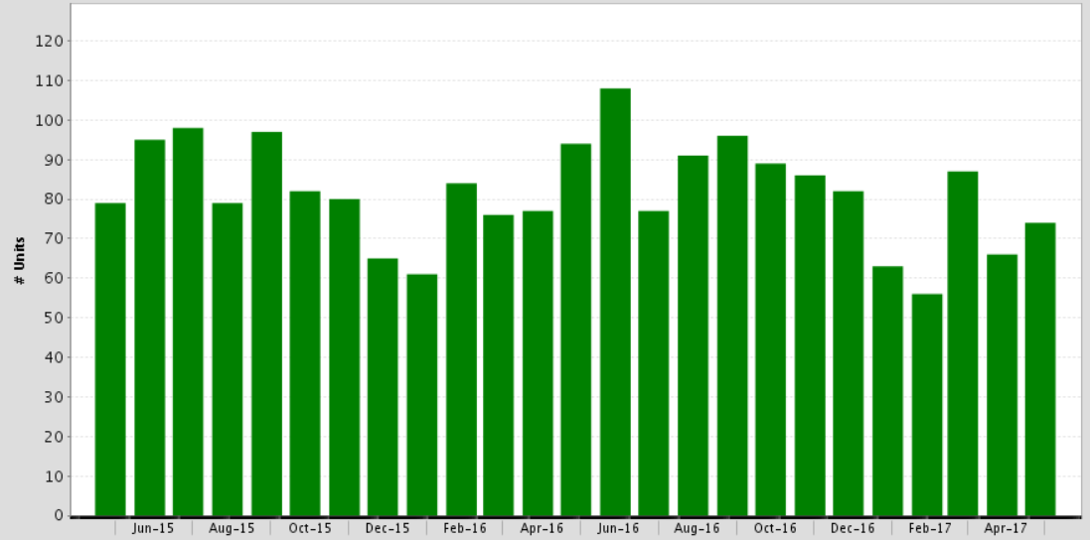
Sales of Single Family Homes
Salinas, May 2017: 74 Units
-11.7% 2017 YTD, -21.3% YTY
SOURCE: Clarus Market Metrics
Notes:
41

Slide 42
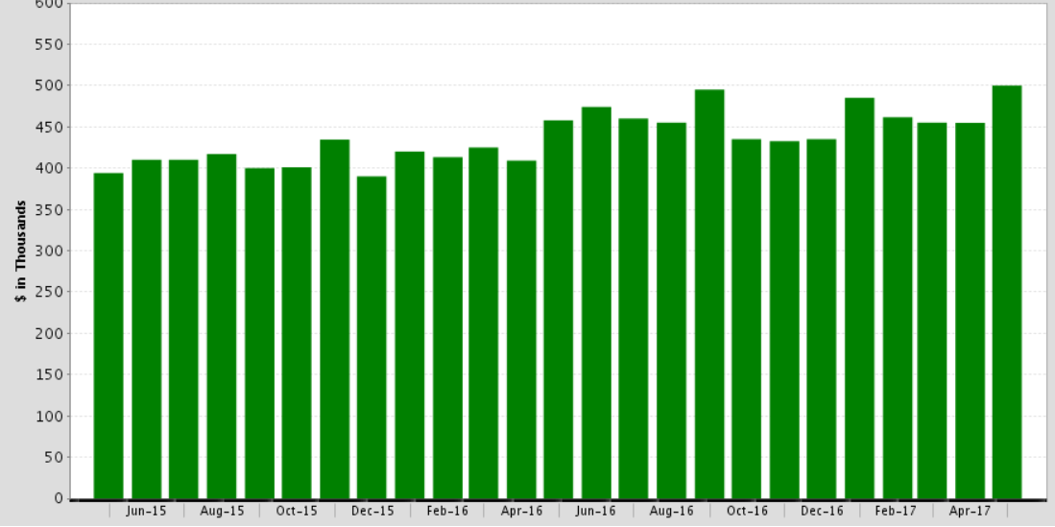
Median Price of Single Family Homes
Salinas, May 2017: $500,000
Up 10.0% MTM, Up 9.2% YTY
SOURCE: Clarus Market Metrics
Notes:
42

Slide 43
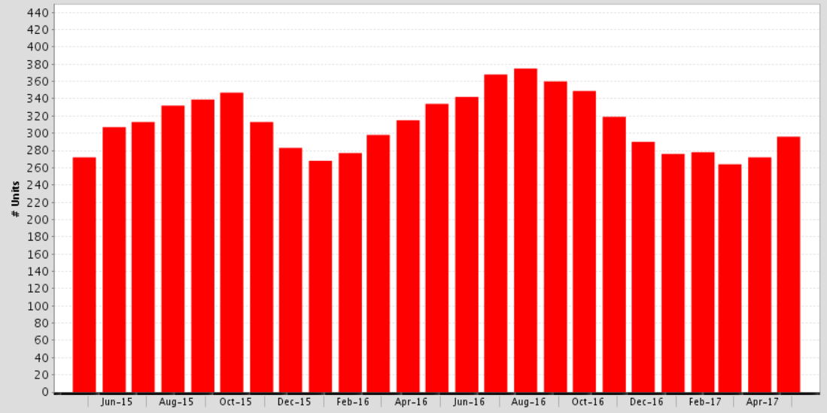
For Sale Properties
Salinas, May 2017: 295 Units
-7.2% 2017 YTD, -11.7% YTY
Note: “For Sale Properties” represents the overall supply that exist throughout the entire month, including any listings that appear as “Active” any point in time during the month.
SOURCE: Clarus Market Metrics
Notes:
43

Slide 44
City of Monterey

Slide 45
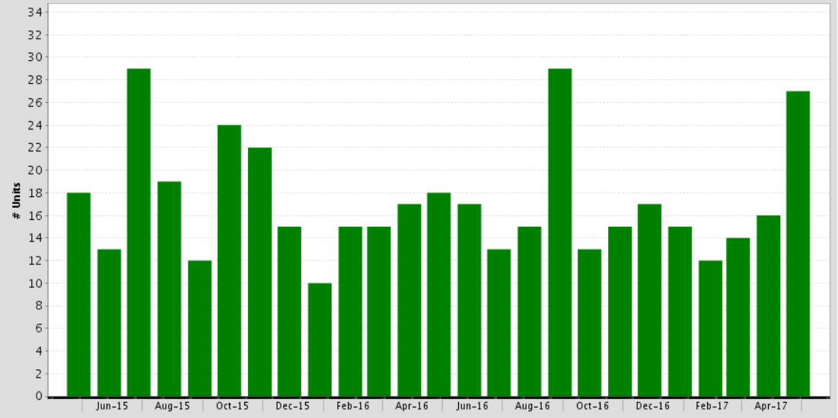
Sales of Single Family Homes
City of Monterey, May 2017: 27 Units
-8.5% 2016, +12.0% 2017 YTD, +50.0% YTY
SOURCE: Clarus Market Metrics
Notes:
45

Slide 46
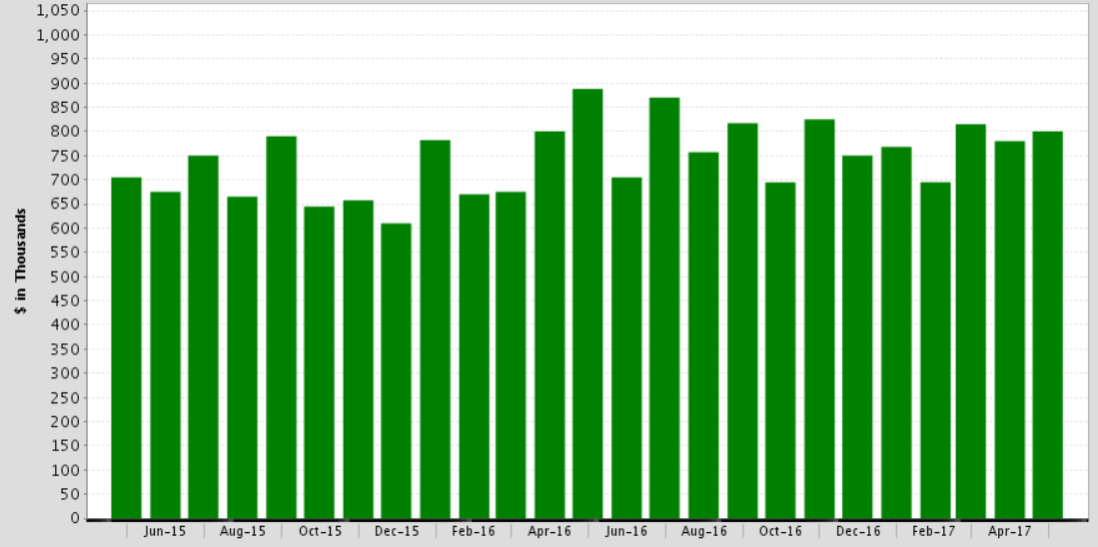
Median Price of Single Family Homes
City of Monterey, May 2017: $800,000
Up 2.6% MTM, Down 9.9% YTY
SOURCE: Clarus Market Metrics
Notes:
46

Slide 47
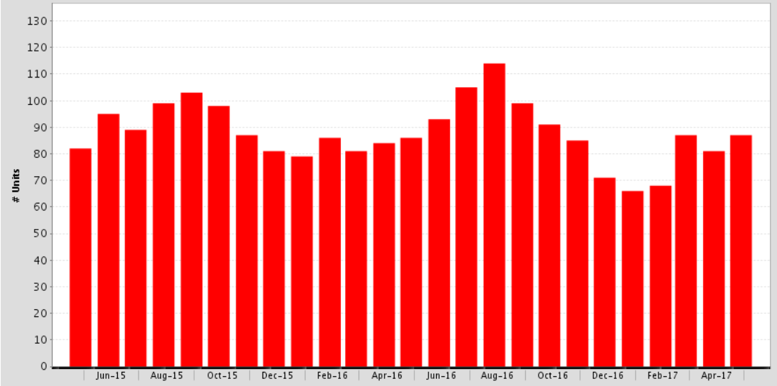
For Sale Properties
City of Monterey, May 2017: 87 Units
+0.2% 2016, -6.5% 2017 YTD, +1.2% YTY
Note: “For Sale Properties” represents the overall supply that exist throughout the entire month, including any listings that appear as “Active” any point in time during the month.
SOURCE: Clarus Market Metrics
Notes:
47

Slide 48
Carmel

Slide 49
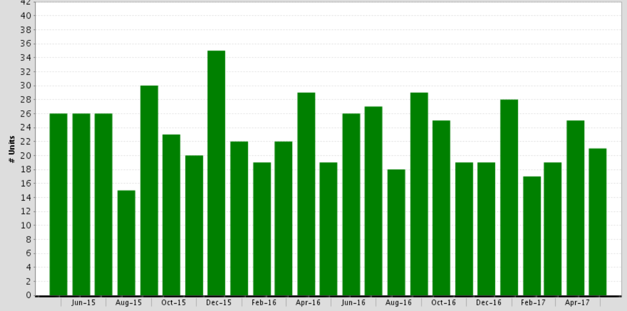
Sales of Single Family Homes
Carmel, May 2017: 21 Units
+0.4% 2016, -0.7% 2017 YTD, +10.5% YTY
SOURCE: Clarus Market Metrics
Notes:
49

Slide 50
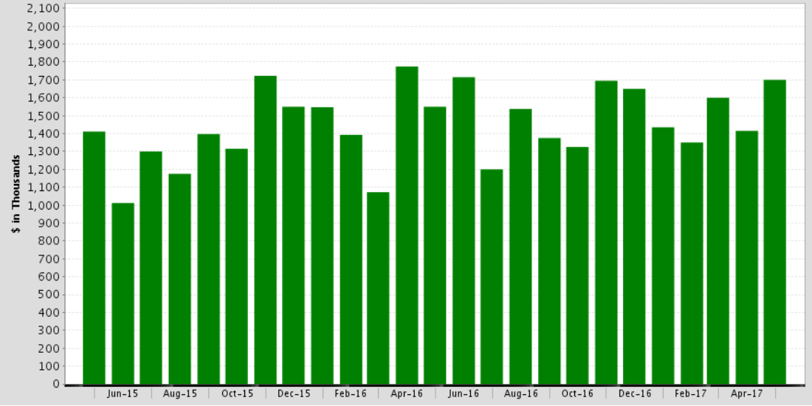
Median Price of Single Family Homes
Carmel, May 2017: $1,700,000
Up 20.1% MTM, Up 9.7% YTY
SOURCE: Clarus Market Metrics
Notes:
50

Slide 51
Supply & Affordability: Connecting the Dots

Slide 52
Housing Affordability Peaked Q1 2012
Prices v. Low Rates and Income Growth
California vs. U.S. – 1984-2017
Annual
Quarterly
SERIES: Housing Affordability Index of Traditional Buyers
SOURCE: CALIFORNIA ASSOCIATION OF REALTORS®
Notes:
C.A.R.’s traditional Housing Affordability Index (HAI) was replaced with the First-Time Buyer Housing Affordability Index (FTB-HAI) in 2006.
Note this slide takes the average of the 3 months in each of the quarters.
C.A.R. began producing its Housing Affordability Index (HAI) in 1984. At that time, fixed-rate mortgages were the prevailing form of financing a home purchase, while the calculations used to produce the HAI reflected a 20 percent down payment. The methodology also assumed a monthly payment for principal, interest, taxes and insurance that was no more than 30 percent of a household’s income. In the more than two decades since the CALIFORNIA ASSOCIATION OF REALTORS® first conceived the HAI, the mortgage finance landscape has changed dramatically. The range of mortgage products available to buyers as well as underwriting criteria has changed. C.A.R. developed the new index measuring affordability for first-time home buyers to better reflect the realities of today’s real estate market.

Slide 53
What Will Happen When Mortgage Rates Increase?
Q1-2017 Median Price $496,620
20% Downpayment
MONTHLY MORTGAGE
Minimum Qualifying Income
INTEREST RATE
INTEREST RATE
SERIES: Housing Affordability Index
SOURCE: CALIFORNIA ASSOCIATION OF REALTORS®

Slide 54
Housing Affordability Index - CA
What Will Happen When Mortgage Rates Increase?
% OF HOUSEHOLDS THAT CAN BUY, ALL ELSE CONSTANT
Q1-2017 Median Price $496,620
20% Downpayment
INTEREST RATE
SERIES: Housing Affordability Index
SOURCE: CALIFORNIA ASSOCIATION OF REALTORS®

Slide 55
Homeownership: CA at 50 year low
California/U.S. 10.3% gap in 2016
SERIES: Homeownership Rates
SOURCE: U.S. Census Bureau
Notes:
But California rate has lagged US rate by 10+ percent for most of period

Slide 56
CA: 12 of 20 largest cities majority renters
City | # Hhlds | # Owners | Ownership %
Los Angeles | 1,360,164 | 489,367 | 36.0%
San Diego | 497,663 | 225,624 | 45.3%
San Francisco | 356,916 | 127,804 | 35.8%
San Jose | 323,133 | 183,019 | 56.6%
Sacramento | 177,131 | 81,025 | 45.7%
Long Beach | 167,660 | 65,380 | 39.0%
Fresno | 163,473 | 74,671 | 45.7%
Oakland | 161,104 | 62,735 | 38.9%
Bakersfield | 114,383 | 66,085 | 57.8%
Anaheim | 99,991 | 43,468 | 43.5%
SERIES: California Net Domestic Migration
SOURCE: U.S. Census Bureau, American Community Survey

Slide 57
CA: 12 of 20 largest cities majority renters
City | # Hhlds | # Owners | Ownership %
Stockton | 94,561 | 45,892 | 48.5%
Riverside | 92,408 | 50,101 | 54.2%
Irvine | 91,186 | 42,073 | 46.1%
Chula Vista | 79,461 | 46,645 | 58.7%
Huntington Beach | 75,158 | 42,652 | 56.7%
Glendale | 74,215 | 24,521 | 33.0%
Fremont | 73,846 | 45,279 | 61.3%
Santa Ana | 72,177 | 32,567 | 45.1%
Modesto | 70,114 | 37,951 | 54.1%
Oceanside | 64,200 | 36,724 | 57.2%
SERIES: California Net Domestic Migration
SOURCE: U.S. Census Bureau, American Community Survey

Slide 58
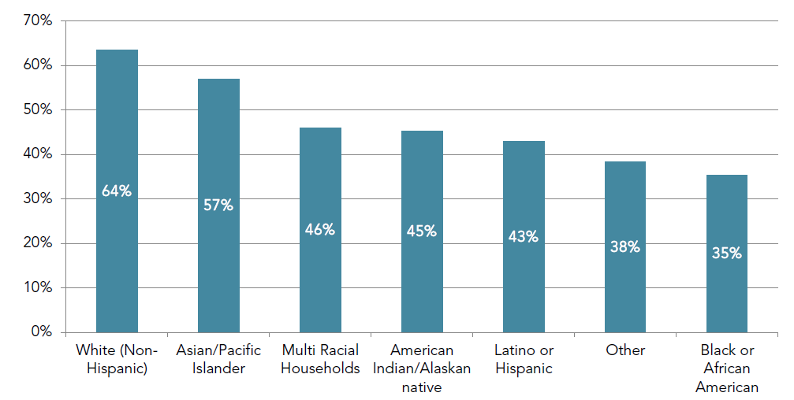
Homeownership Rates Differ by Ethnicity
California Homeownership Rates by Race and Ethnicity (2010-2014 Average)
SERIES: Homeownership rate by ethnicity
SOURCE: CA HCD, PolicyLink, USC Program for Environmental and Regional Equity
Notes:
The homeownership gap between White and minority households is another feature of the housing market that has experienced limited changes during the past two decades. The homeownership gap between White households and Black and Hispanic households remains at more than 20 percentage points. Using 1989 data, Wachter and Megbolugbe (1992) estimated that about 80 percent of the gap between White households and Black and Hispanic households can be explained by differences in endowment (including differences in income, education, age, gender, and family type).

Slide 59
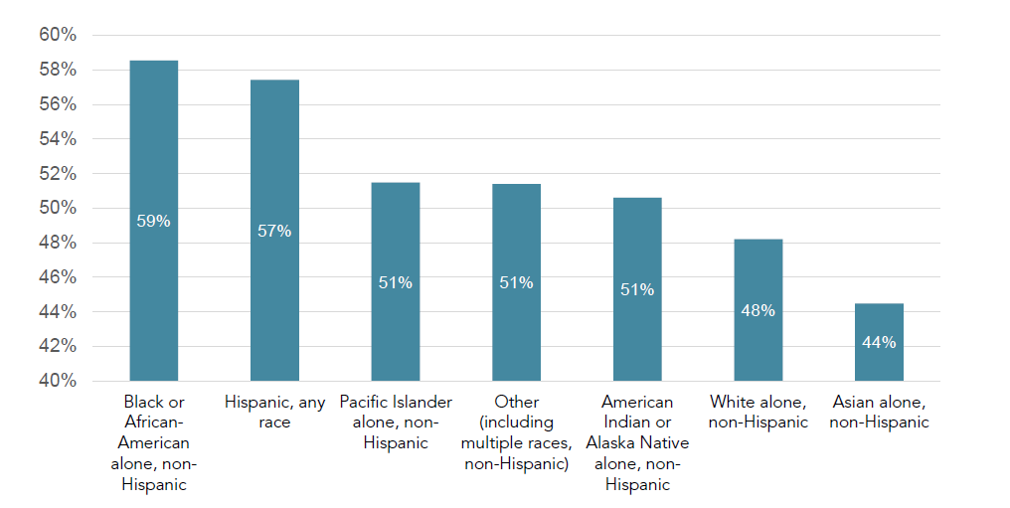
Housing-Cost Burden Is not Distributed Evenly across Ethnicity
Percent of California Households Paying over 30 Percent of Income toward Housing (2009 – 2013)
SERIES: Homeownership rate by ethnicity
SOURCE: CA HCD, HUD CHAS data set, US Census Bureau
Notes:
Housing-cost burden is experienced disproportionately by people of color. The above graph looks across all income levels in the State and shows that the percentage of renters paying more than 30 percent of their income toward rent is greater for households that identify as Black or African-American, Latino or Hispanic, American Indian or Alaska Native, or Pacific Islander, compared to renter households that identify as White. This may become an ever-greater factor in the need for affordable housing as population trends suggest that California will become increasingly diverse in the coming decades.

Slide 60
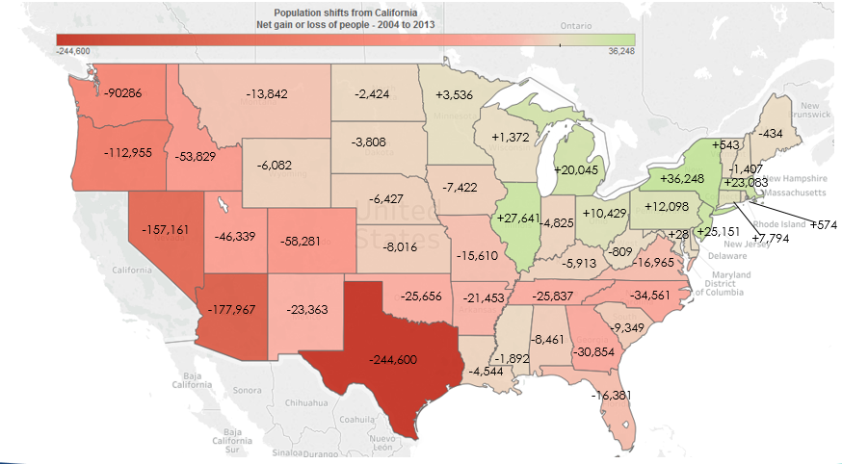
CA Population Net Gain/Loss (2004 - 2013)
Left CA: 5 million
Came to CA: 3.9 million
Net Loss: 1million
SERIES: People Leaving/Coming to California
SOURCE: IRS, Sacramento Bee

Slide 61
Austin: 70%
Raleigh: 40%
Portland: 30%

Slide 62
“Missing” 80,000 New Units Annually
2016: 98,881 (47,889 sf, 50,992 mf)
2017f: 100,246 (51,720 sf, 48,526 mf )
CA HCD Projected Housing Needs:
180,000/yr.
SERIES: California New Housing Permits
SOURCE: Construction Industry Research Board

Slide 63
Most Underbuilt Counties in California
SERIES: Nonfarm Job Growth & Housing Affordability Index (HAI)
SOURCE: CA EDD, Construction Industry Research Board

Slide 64
Most Underbuilt Counties in California
SERIES: Nonfarm Job Growth & Housing Affordability Index (HAI)
SOURCE: CA EDD, Construction Industry Research Board

Slide 65
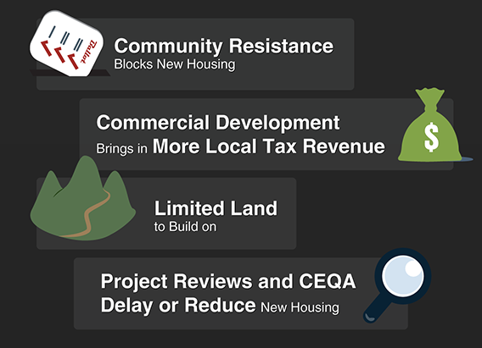
California Not Building Enough Because…
SOURCE: CA Legislative Analyst Office

Slide 66
Housing Affordability In CA: Monterey 23%
2017-Q1: % able to purchase median-priced home
SERIES: Housing Affordability Index of Traditional Buyers
SOURCE: CALIFORNIA ASSOCIATION OF REALTORS®

Slide 67
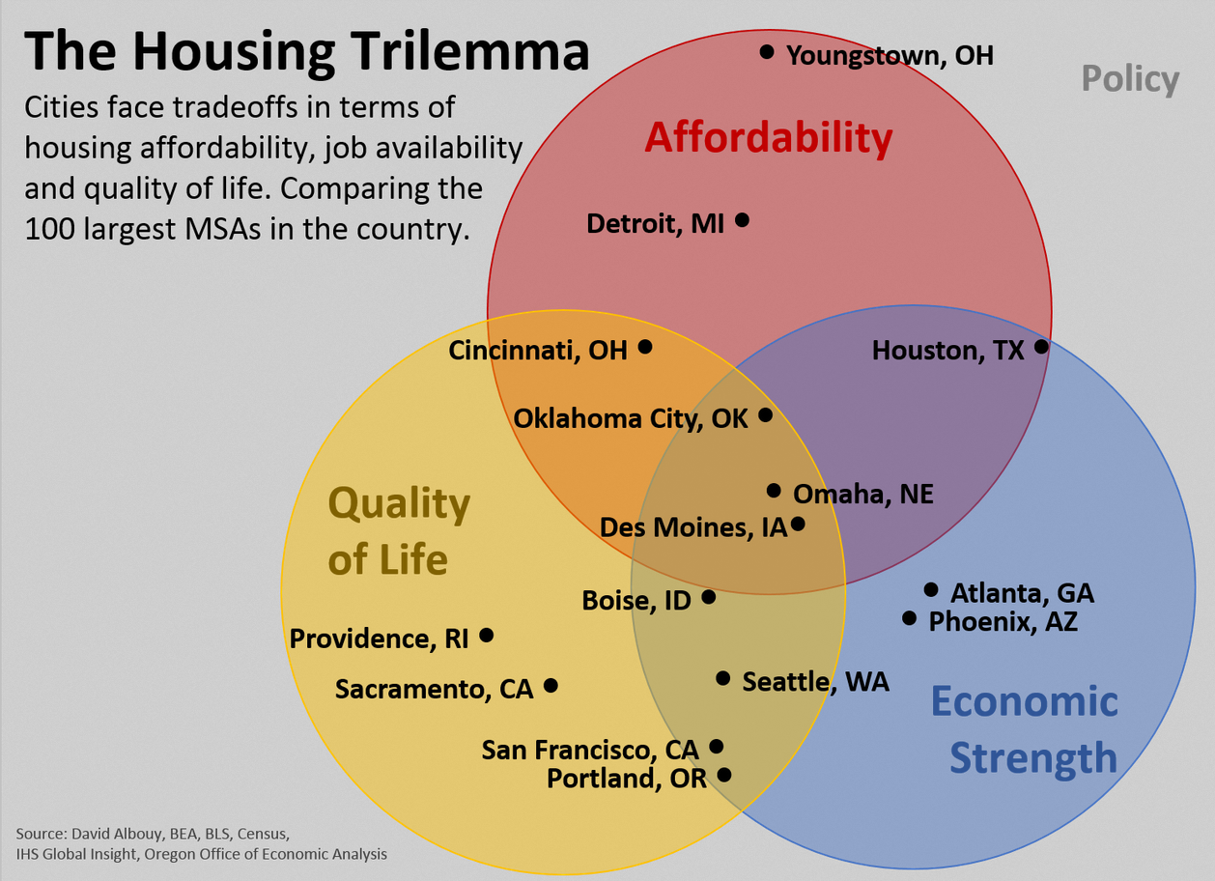

Slide 68
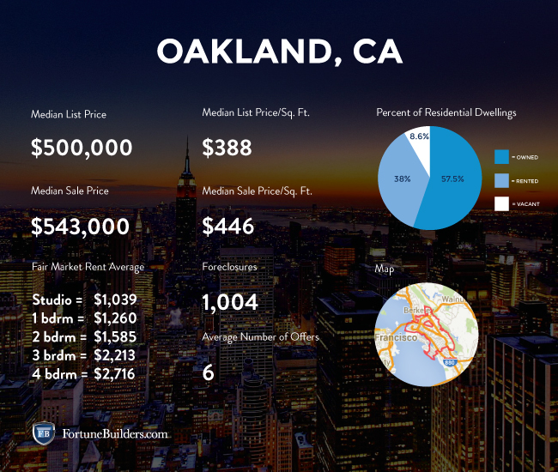
The median income in Oakland is $47,000, which translates to $1,175/month for rent, but the average monthly rent in Oakland is $3,000.

Slide 69
Prediction: In 5 Years CA Will be a Majority Renter State

Slide 70
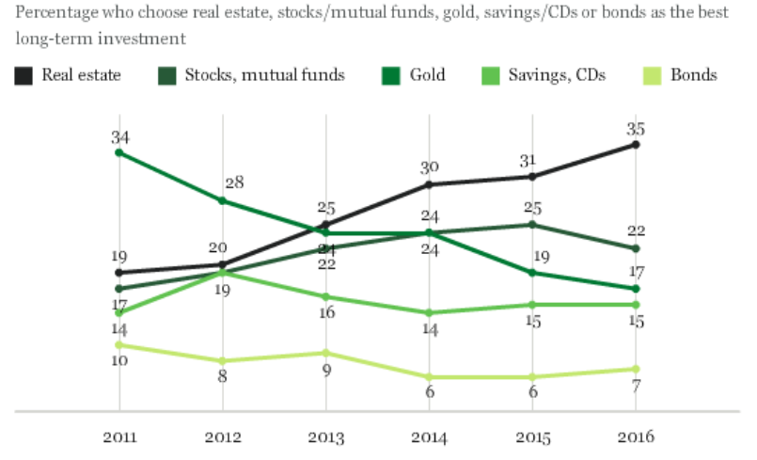
Real Estate is Still Considered the Best
Long Term Investment
SOURCE: Gallup

Slide 71
Nearly ½ Renters Plan to Buy a Home
When do you plan to buy your next home?

Slide 72
55% Already Preparing to Buy a Home
Have you made any of the following preparations to buy a home? Please select all that apply.
Notes:
Other: Improved credit score, Saved, visited open houses

Slide 73
69% of Millennial renters would buy with low-down
If You knew you could qualify with lower down-payment, would you start to look for a house?
SERIES: 2016 Generations / Millennials Survey
SOURCE: CALIFORNIA ASSOCIATION OF REALTORS®

Slide 74
Only 19% Know about FHA Loans
FHA backed loans only require a 3.5% down-payment.
SERIES: 2016 Generations / Millennials Survey
SOURCE: CALIFORNIA ASSOCIATION OF REALTORS®

Slide 75
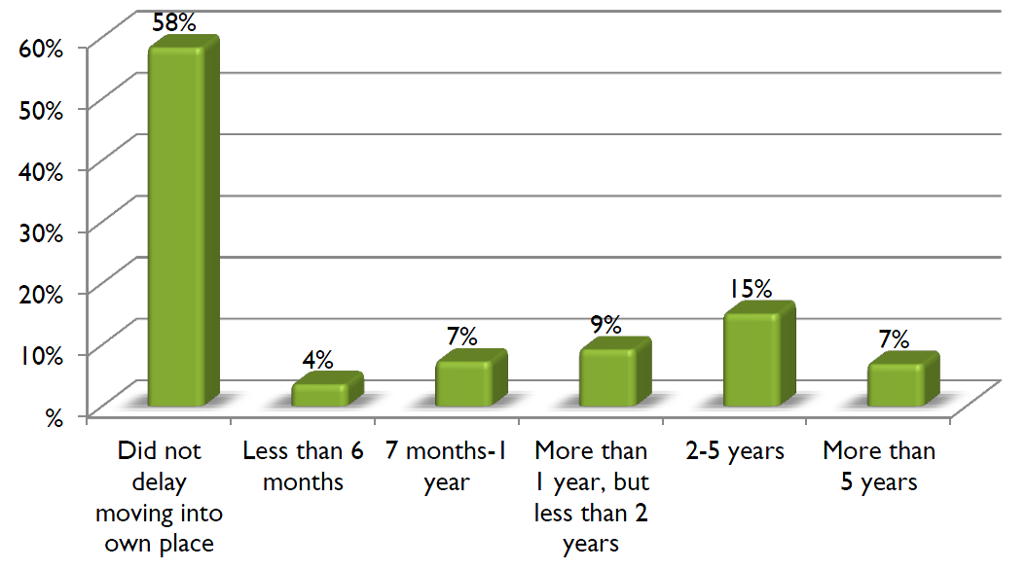
Has Student Debt Delayed Decisions to Move?
% of Loan borrowers
SERIES: 2016 Student Loan Debt and Housing Report
SOURCE: National Association of Realtors®
Notes:
In April 2016, SALT® distributed a 33 question survey written by NAR and SALT® to 75,000 student loan borrowers who are currently in repayment. A total of 3,230 student loan borrowers completed the survey. The survey had a response rate of 4.3 percent.

Slide 76

Today the Nation’s Best Performing Cities Are Everywhere
Milken Institute Annual Report 2016

Slide 77
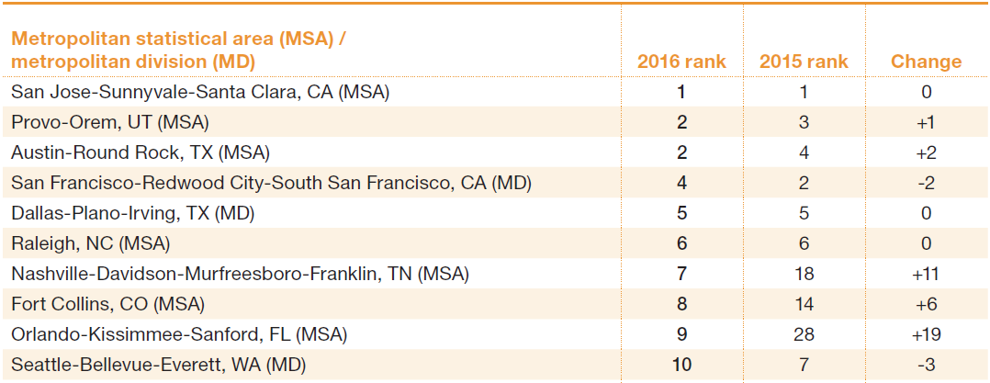
Top Ten Best-Performing Large Cities
Source: Milken Institute.
Notes:
San Jose-Sunnyvale-Santa Clara, CA, repeats as the top-performing large metro in the nation. The Top 6 large metros in our 2016 rankings repeated from last year, and the most that any of them shifted was two places. All have major tech sector clusters and high rates of entrepreneurship. In all, 19 of last year’s Top 25 metros made the cut in 2016. Metros with competitive advantages in professional and technical services are experiencing the most robust advances. This includes a broad array of technology services sectors, such as scientific research and development; architecture and engineering; computer systems design and related services; specialized design; and technical consulting. Metros with a high concentration of these tech services and strong climates for entrepreneurship are among the leaders in the 2016 Best-Performing Cities.
A key source of weakness around the nation has been the sustained collapse in oil prices, which has caused a massive retrenchment in shale oil exploration activity and overall drilling investment. Regions that experienced a burst of economic growth from 2010 through 2014 amid high oil prices and shale oil drilling exploration have seen a dramatic deceleration since then, with several experiencing declines in employment. Even Houston, the top oil and gas cluster in the nation, while not a site of shale-related exploration, has experienced a significant economic slowdown because of the energy industry’s high interdependence.

Slide 78
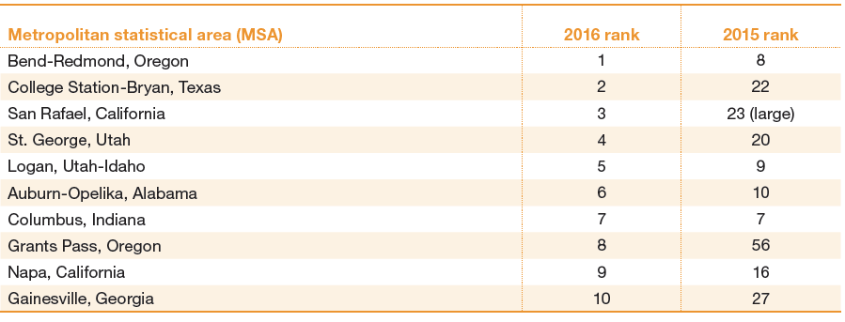
Top Ten Best-Performing Small Cities
Source: Milken Institute

Slide 79
Lack of Turnover: Causes and Consequences

Slide 80
Where is the Inventory?
Long-Time Homeowners are not moving as in the past
  Low rate on current mortgage
  Low property taxes
  Capital gains hit
  Where can I afford to go?
  Could not qualify for a mortgage today
Remodel and stay
Are we headed for the “European Model” where children inherit the home of their parents?
One more thing…Secular decline in marriage

Slide 81
Fewer Units Turning Over Since the Great Recession
Housing Turnover Rate
(Single-Family Homes only)
CA turnover rate trend
SERIES: Percent of existing single-family homes being sold
SOURCE: Census Bureau, American Community Survey, Moody’s Analytics, C.A.R.

Slide 82
Years Owned Before Selling: Historic Highs
SERIES: 2016 Housing Market Survey
SOURCE: CALIFORNIA ASSOCIATION OF REALTORS®

Slide 83
Boomers Not Moving as Often
71% of Californian’s aged 55+ haven’t moved since 1999
SERIES: Distribution of Home Ownership by Year Moved In
SOURCE: U.S. Census Bureau, 2013 American Housing Survey

Slide 84
Remodeling at an all-time high in 2016
SOURCE: California Homebuilding Foundation (CHF)/Construction Industry Research Board (CIRB)
Downloaded from Moody’s Analytics
Notes:
Another angle on low turnover—reinvesting in your current home for the long haul so you don’t have to move. The value of residential alterations/additions permits in California is at an all-time high through the first 7 months of 2016 compared with the first 7 months of any other year ever. Also accelerating this year—up 16% over last year and the strongest growth for the series this cycle.

Slide 85
California’s Single-Family Housing Stock
SOURCE: U.S. Census Bureau, Annual Social and Economic Supplement (ASEC) to the Current Population Survey (CPS)
Downloaded from the National Bureau of Economic Research (NBER)

Slide 86
More Single Family Units Now Rentals
Potentially between 400,000 and 700,000 SF Rentals that Used to be Owner-Occupied
SOURCE: U.S. Census Bureau, Annual Social and Economic Supplement (ASEC) to the Current Population Survey (CPS)
Downloaded from the National Bureau of Economic Research (NBER)

Slide 87
Most Have Equity in their Home
Do you have equity in your home?
SERIES: 2016 Baby Boomer Survey
SOURCE: CALIFORNIA ASSOCIATION OF REALTORS®
Notes:
Q28

Slide 88
Majority Do Not Plan to Sell When they Retire
Do you plan to sell your current home when you retire?
SERIES: 2016 Baby Boomer Survey
SOURCE: CALIFORNIA ASSOCIATION OF REALTORS®
Notes:
Q8

Slide 89
Do you worry about fewer opportunities for your kids?
Do you worry about your children or grandchildren not having the same opportunities to succeed as you did?
SERIES: 2016 Generations / Boomer Survey
SOURCE: CALIFORNIA ASSOCIATION OF REALTORS®
Notes:
Q20

Slide 90
77% Say They Have or Will Help Kids Buy a Home
Are you planning to provide help for your children to buy a home by contributing to their down payment or mortgage payments?
SERIES: 2016 Generations / Boomer Survey
SOURCE: CALIFORNIA ASSOCIATION OF REALTORS®
Notes:
Q21

Slide 91
The Forecast

Slide 92
California Housing Market Outlook
 | 2011 | 2012 | 2013 | 2014 | 2015 | 2016 | 2017f
SFH Resales (000s) | 422.6 | 439.8 | 414.9 | 382.7 | 409.4 | 416.3 | 419.6
% Change | 1.4% | 4.1% | -5.9% | -7.8% | 7.0% | 1.7% | 0.8%
Median Price ($000s) | $286.0 | $319.3 | $407.2 | $446.9 | $476.3 | $502.3 | $525.4
% Change | -6.2% | 11.6% | 27.5% | 9.8% | 6.6% | 5.4% | 4.6%
Housing Affordability Index | 53% | 51% | 36% | 30% | 31% | 31% | 28%
30-Yr FRM | 4.5% | 3.7% | 4.0% | 4.2% | 3.9% | 3.6% | 4.4%
SERIES: CA Housing Market Outlook
SOURCE: CALIFORNIA ASSOCIATION OF REALTORS®

Slide 93
Mind-Set for Change

Slide 94

Notes:
Program Overview
The who/what/when/why
C.A.R.’s role
Appeal process
Annual Deadline: Dec 31st
Current Compliance Cycle:
July 1, 2016 – December 31, 2017

Slide 95

“You will be the same person in five years as you are today except for the people you meet, the places you go and the books you read.”

Slide 96



1992
1996
2006
Notes:
CHANGE. For most of us, change in a work context means more - more work, more uncertainty, more mistakes, more anxiety and a more emotionally-charged work environment. And for good reason! Change brings about times of flux. Times when the future is uncertain, and the payoff unknown. But here's the ultimate truth - change is one of two things; either reactive or proactive. Change is not an option. It hasn't been in over 25 years. Change is the lifeblood of your business. To keep ahead of the competition - both as an individual and as a part of an organization - you must be changing; as quickly and as intelligently as you can. Competition is fierce like never before. Change or Die deconstructs and debunks age-old myths about change and empowers us with three critical keys relate, repeat, and reframe to help us make important positive changes in our lives. Explaining breakthrough research and progressive ideas from a wide selection of leaders in medicine, science, and business (including Dr. Dean Ornish, Mimi Silbert of the Delancey Street Foundation, Bill Gates, Daniel Boulud, and many others)

Slide 97




2017 SPF Book Recommendations

Slide 98




Slide 99

Notes:
The all-new Housing Matters Podcast is your housing hub for market analysis, economic trends, and housing news from the CALIFORNIA ASSOCIATION OF REALTORS® (C.A.R.) and its institute the Center for California Real Estate. Be sure to subscribe on iTunes to hear the latest episode every other Friday to learn what you need to know about the market from C.A.R. experts who will give you their take on the week’s top real estate stories.

Slide 100


Slide 101


