Slide 1

monterey real estate market outlook
Monterey County AOR
April 5, 2019
Leslie Appleton-Young
SVP & Chief Economist

Slide 2
value of strategic thinking:
“you will be surprised by the future, but you won’t be surprised that you are surprised”

Slide 3

overview
Not As Bad As You’ve Heard
  Economic fundamentals solid
  Sales Bounced Back Modestly
  Listings Growth Decelerating
  Price Growth Stabilizing
But Don’t Pop the Champagne Just Yet
  Sales Still Falling From Last Year
  Price Growth Poised For Slower Growth
  Affordability has eroded a LOT
  Market Much Less Competitive
2019: Tough But Manageable

Slide 4
macro outlook

Slide 5




fundamentals remain strong but…
2.6%
2.8%
2.1%
GDP 2018-Q4
Consumption
2018-Q4
Core CPI
February 2019
3.8%
1.7%
Unemployment
February 2019
Job Growth
February 2019
Notes:
Unprecedented stimulus

Slide 6
growth slowed at the end of 2018
GDP: 2018: 2.9% 2019:2.4%
ANNUALLY
QUARTERLY
2009 Largest Annual Drop since 1946 (-2.8%)
SEIRES: GDP
SOURCE: US Dept. of Commerce, Bureau of Economic Analysis
Notes:
6

Slide 7
labor market tightest in bay area

Slide 8
anxiety attack! confidence fell sharply in march
2019: feb 131.4 march 124.1
SERIES: Consumer Confidence
SOURCE: The Conference Board
Notes:
Confidence has been volatile:
Feb jobs report was very weak
Financial market instability
Partial government shut-down
Overall tend in confidence has been softening since last summer – in line with moderation in economic growth

Slide 9
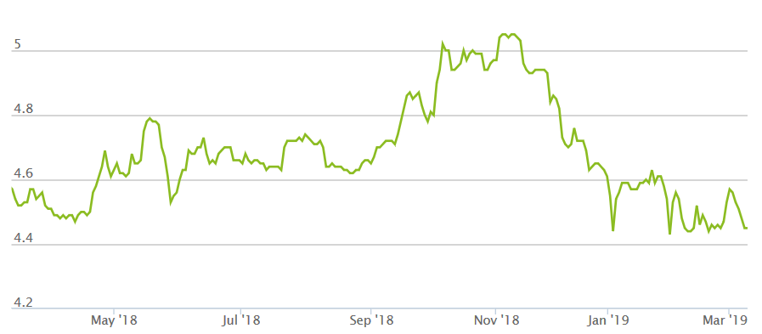
good news: mortgage rates @ 10 month low
April 4: 4.08%
SERIES: Average 30 Yr. Fixed Mortgage Rates
SOURCE: Mortgage News Daily

Slide 10
reprieve – no more fed hikes this year
January 2012 – April 2019
MONTHLY
WEEKLY
SERIES: 30Yr FRM, 5Yr ARM, Fed Funds Rate (Target Rate)
SOURCE: Freddie Mac, St. Louis Fed
Notes:
9 increases since Dec 2015/ 4 in 2018
Last meeting 3/21/19
On 3/20/19 the Fed cut its growth forecast
China and Europe and deteriorating economically
Concerns about Us consumer spending
Bond market it happy – higher rates reduce the value of bond funds
Bonds: provide safe haven for capital and guaranteed positive returns
Netural stance – stocks recovering too

Slide 11
always lots of wildcards
escalating trade war
stock/financial market volatility
federal overshoot on reducing portfolio
gse reform
tax bill
2019 ipo’s: uber, lyft, airbnb, slack, wework, planatir tech, pinterest, postmates, robinhood

Slide 12
Bay Area Economic Profile
19th largest economy - $748b gdp
per capital gdp = $80,000 highest of any similar msa
4.3% job growth over last 3 years -- 2x as fast as u.s.
+26% employment growth since last recession
750,000 tech workers as of july 2017
Migration is net positive: july 2016-july 2017
  net outflow o 45,670 to other parts of u.s.
  net inflow of 58,156 from outside of the u.s.
  ECONOMIC JUGGERNAUT (a huge, powerful, and overwhelming force)
Notes:
Tech grows at the expense of older parts of the economy
Soaring housing costs are hurting the region’s economic diversity
Unwilling to densify

Slide 13
california realtors
& the real estate industry

Slide 14
c.a.r. membership disconnect from sales
Sales Peaks: 1978, 1988, 2004-05, 2009
Membership Peaks: 1980, 1990, 2006, 2018
Notes:
Membership has been rising since 2012
Variable dues formula compliance program
Data for 2017 - 2019
424.1
417.6
416.8
197.700
205,600
211,250

Slide 15
more of everything, except home sales…

Slide 16
significant drop in sides per member

Slide 17
your competition: you yesterday and every agent working just as hard as you do

Slide 18
2009

Slide 19
what is a normal market ?
SERIES: Distressed Sales, Not Seasonally Adjusted
SOURCE: CALIFORNIA ASSOCIATION OF REALTORS®
Notes:
19
The new normal after the financial crisis began in Jan 2014
My point here is that we all need to reset what we consider to be a normal market
For sellers the normal market is what their neighbors house sold for last year.
We are long past the “recovery”

Slide 20
“market shift”

Slide 21
march rebound!
CA, February 2019 Sales: 399,080 Units, -9.0% YTD, -5.6% YTY
Feb-18: 422,910
Feb-19: 399,080
SERIES: Sales of Existing Single Family Homes
SOURCE: CALIFORNIA ASSOCIATION OF REALTORS®
*Sales are seasonally adjusted and annualized
Notes:
We can all agree that Dec and Jan were not
Good news is that Feb was much better

Slide 22
ca sales down 10 months in a row
*Sales are seasonally adjusted and annualized
SERIES: Sales of Existing Single Family Homes
SOURCE: CALIFORNIA ASSOCIATION OF REALTORS®

Slide 23
Here’s the twist: sales off at all price points
february 2019 (yty% chg.)
SERIES: Sales of Existing Detached Homes
SOURCE: CALIFORNIA ASSOCIATION OF REALTORS®
Notes:
Data found in MPPA

Slide 24
prices growing modestly
ca, february 2019: $534,140, -0.6% mtm, +2.2% yty
Feb-19: $534,140
Feb-18: $522,440
SERIES: Median Price of Existing Single Family Homes
SOURCE: CALIFORNIA ASSOCIATION OF REALTORS®

Slide 25
Bay Area: Peak v. Current Price
SERIES: Median Price of Existing Detached Homes
SOURCE: CALIFORNIA ASSOCIATION OF REALTORS®

Slide 26
So Cal: Orange & SD Above Prior Peak
SERIES: Median Price of Existing Detached Homes
SOURCE: CALIFORNIA ASSOCIATION OF REALTORS®

Slide 27
Central Coast: SC & SLO
SERIES: Median Price of Existing Detached Homes
SOURCE: CALIFORNIA ASSOCIATION OF REALTORS®

Slide 28
Central Valley: All Below Prior Peak
SERIES: Median Price of Existing Detached Homes
SOURCE: CALIFORNIA ASSOCIATION OF REALTORS®

Slide 29
inventory (sales/listings) highest point in 3 years
february 2018: 3.9 months; 2019: 4.6 months
Note: “Unsold Inventory Index” represents the number of months it would take to sell the remaining inventory for the month in question. The remaining inventory for the month is defined as the number of properties that were “Active”, “Pending”, and “Contingent” (when available) and divide the sum by the number of “Sold” properties for the month in question.
SERIES: Unsold Inventory Index of Existing Single Family Homes
SOURCE: CALIFORNIA ASSOCIATION OF REALTORS®
Notes:
Range since 1988:
Low: 1.3 months in May 2004
High: 18.8 months in Apr 1991
Long-run average: 6.9 months

Slide 30
and…gain in yty active listings is slowing
SERIES: Active Listing of Existing Single Family Homes
SOURCE: CALIFORNIA ASSOCIATION OF REALTORS®
Notes:
Data from Sales vs Listings

Slide 31
active listings by month
Notes:
From Jordan

Slide 32
inventory up in most segments
Feb 2019
SERIES: Active Listings of Existing Single Family Homes
SOURCE: CALIFORNIA ASSOCIATION OF REALTORS®
Notes:
Data from UIPR

Slide 33
more listings = more sales?
Feb 2019
SERIES: Sales and Listings of Existing Single Family Homes
SOURCE: CALIFORNIA ASSOCIATION OF REALTORS®
Notes:
Data from sales vs listings

Slide 34
price movement varies by region

Slide 35
bay area -.9% price drop reflects shifting mix
Feb 2019
SERIES: Active Listings of Existing Single Family Homes
SOURCE: CALIFORNIA ASSOCIATION OF REALTORS®
Notes:
Data from UIPR

Slide 36
price reductions reflect new realities
Listings with a Reduced Price: 38.3%; Median Drop: -4.3%
SERIES: Listing Price of Existing Single Family Homes
SOURCE: CALIFORNIA ASSOCIATION OF REALTORS®
Notes:
From Jordan

Slide 37
regional housing market update

Slide 38
sales down throughout region

Slide 39
larger declines than rest of the state

Slide 40
monterey

Slide 41
Home Sales on the Decline

Slide 42
Not Quite As Bad As Rest of CA

Slide 43
Top End of Market Beginning to Fall Too

Slide 44
Not All Markets Trending Together

Slide 45
Market Competitiveness

Slide 46
Market IS Getting Less Competitive

Slide 47
Across Many Price Points

Slide 48
Again, Not All Markets Created Equal

Slide 49
Active Listings

Slide 50
Buyers Have More Options to Choose From

Slide 51
Especially Below $750K

Slide 52
More Listings Across Most Parts of Region

Slide 53
Median Prices

Slide 54
Prices Have Been on a Tear

Slide 55
However, Starting to Lose Momentum

Slide 56
Lots of Diversity in Price Segments

Slide 57
Lower-Priced Areas Seeing Growth Slow

Slide 58
2/19: how is the monterey market?
great to good
sales have turned the corner
price gains moderating almost everywhere
active listings increasing but not nearly as fast
time on market increasing
more price reductions & low rates = opportunity for buyers

Slide 59
affordability is elusive

Slide 60
monterey: not the lowest in the state - 19%
2018-Q2: % able to purchase median-priced home
SERIES: Housing Affordability Index of Traditional Buyers
SOURCE: CALIFORNIA ASSOCIATION OF REALTORS®

Slide 61
ca housing affordability? it’s not affordable
California, 1984-2018
Annual
Quarterly
SERIES: Housing Affordability Index of Traditional Buyers
SOURCE: CALIFORNIA ASSOCIATION OF REALTORS®
Notes:
C.A.R.’s traditional Housing Affordability Index (HAI) was replaced with the First-Time Buyer Housing Affordability Index (FTB-HAI) in 2006.
Note this slide takes the average of the 3 months in each of the quarters.
C.A.R. began producing its Housing Affordability Index (HAI) in 1984. At that time, fixed-rate mortgages were the prevailing form of financing a home purchase, while the calculations used to produce the HAI reflected a 20 percent down payment. The methodology also assumed a monthly payment for principal, interest, taxes and insurance that was no more than 30 percent of a household’s income. In the more than two decades since the CALIFORNIA ASSOCIATION OF REALTORS® first conceived the HAI, the mortgage finance landscape has changed dramatically. The range of mortgage products available to buyers as well as underwriting criteria has changed. C.A.R. developed the new index measuring affordability for first-time home buyers to better reflect the realities of today’s real estate market.

Slide 62
income required to buy has jumped - alot
SERIES: Housing Affordability Index of Existing Detached Homes
SOURCE: CALIFORNIA ASSOCIATION OF REALTORS®

Slide 63
u.s. v ca homeownership gap
“The Gap”: 3.5% in 1960 9.5% in 2017
SERIES: Homeownership Rates
SOURCE: U.S. Census Bureau
Notes:
But California rate has lagged US rate by 10+ percent for most of period

Slide 64
ca homeownership rate: 2nd lowest in nation
SERIES: Homeownership Rates
SOURCE: U.S. Census Bureau (Current Population Survey)

Slide 65
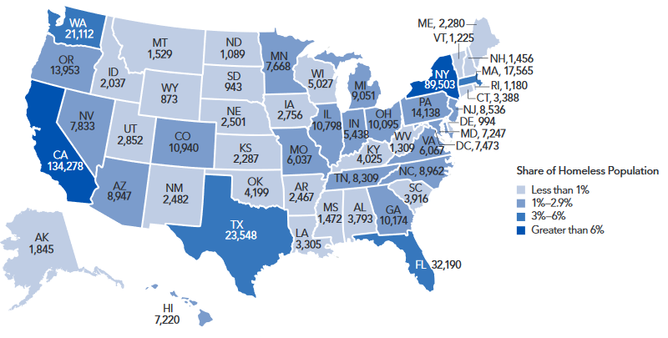
Largest Number of Homeless People
Estimates of Homeless People – By State, 2017
Top 5 State with Largest Increases
(2016 – 2017)
California 16,136/13.7%
New York 3,151/3.6%
Oregon 715/5.4%
Nevada 435/5.9%
Texas 426/1.8%
SERIES: Estimates of Homeless People in January 2017
SOURCE: The U.S. Department of Housing & Urban Development
Notes:
https://www.hudexchange.info/resources/documents/2017-AHAR-Part-1.pdf

Slide 66
by 2025 california will be a majority renter state

Slide 67
Majority Renter Cities

Slide 68
out-migration
“california two step”

Slide 69
More Sellers Continue to Move out of California; Highest since 2007
Location of Seller’s New Home
 | 2005 | 2006 | 2007 | 2008 | 2009 | 2010 | 2011 | 2012 | 2013 | 2014 | 2015 | 2016 | 2017 | 2018
Within the same county | 38% | 41% | 37% | 45% | 47% | 42% | 49% | 49% | 46% | 44% | 44% | 40% | 38% | 36%
In another county in California | 23% | 18% | 24% | 17% | 21% | 21% | 19% | 18% | 20% | 21% | 20% | 21% | 20% | 21%
In another state | 31% | 28% | 29% | 27% | 19% | 20% | 20% | 22% | 19% | 22% | 22% | 25% | 28% | 29%
Out of US | 1% | 2% | 1% | 1% | 2% | 1% | 1% | 1% | 0% | 1% | 1% | 1% | 1% | 1%
Don't Know/Not sure | 7% | 11% | 9% | 10% | 12% | 16% | 10% | 10% | 15% | 13% | 13% | 13% | 14% | 13%
Total | 100% | 100% | 100% | 100% | 100% | 100% | 100% | 100% | 100% | 100% | 100% | 100% | 100% | 100%
SERIES: 2018 Housing Market Survey
SOURCE: CALIFORNIA ASSOCIATION OF REALTORS®

Slide 70
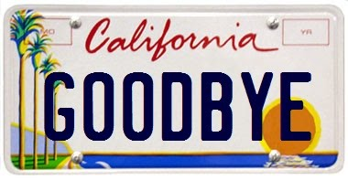
Case Study: Seller Leaving California
Seller’s Profile
Age: 56
Marital Status: Married Couple with Dependents
Income: $200,000
Yrs. Owned: 25
Net cash gain: $1,050,000
Reason for selling: Desired larger home
State moving to: Utah
“We doubled the size of our house and lowered our mortgage payment.”*
Characteristics of Home
Size: 1,948 sq. ft
Property Type: Single-Family Home
Location: Los Angeles County
Price: $1,175,000
“L.A would have been my first choice, and I didn’t want to have to leave California. I couldn’t afford to stay there”*
*Lopez, S. (2017) ‘They’re leaving California for Las Vegas for find middle-class life that eluded them’. Los Angles Times, 3 December
SERIES: 2018 Housing Market Survey
SOURCE: CALIFORNIA ASSOCIATION OF REALTORS®

Slide 71
~750K People Have Left Since 2010

Slide 72
Step 1: Coastal to Cheaper Markets
Elsewhere in CA
Another State

Slide 73
Step 2: Pricing Prior Residents Out of State
Elsewhere in CA
Another State

Slide 74
Q: What needs to be done?
A: Build More Housing

Slide 75
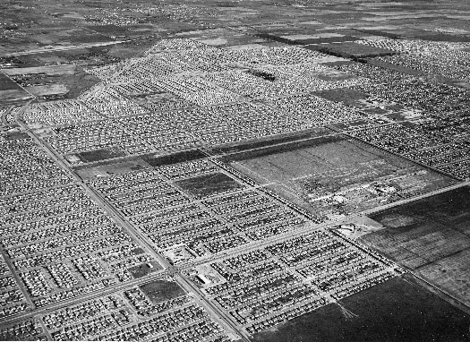
Lakewood CA 1950

Slide 76





Global Capitals Do Density
#10 Shanghai
#43 London
#69 Paris
#35 Rio de Janerio
#27 Mexico City
Source: citymayors.com

Slide 77
U.S. Cities Ranked by Density
#90 Los Angeles
#104 San Francisco/Oakland
#107 San Jose
#119 Honolulu
#120 Las Vegas
#121 Miami
Global Ranking 1-125
www.citymayors.com

Slide 78
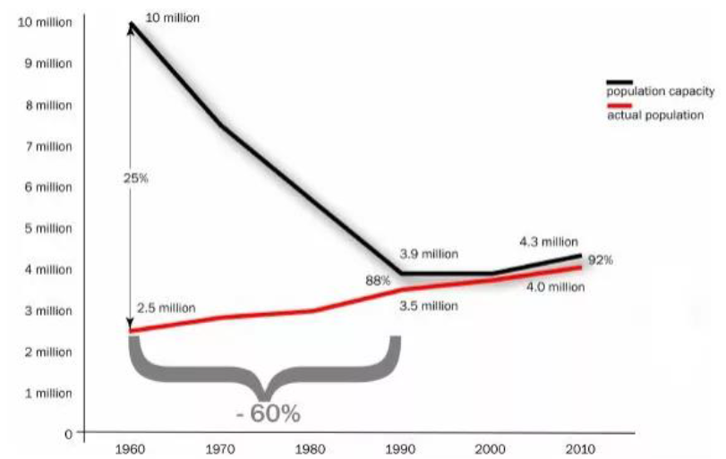
Case Study: Restrictive Zoning in L.A.
Los Angeles Zoned Residential Capacity
1960: Los Angeles zoned to accommodate 10 million people
Today: LA is zoned for only 4.3 million people after decades of population growth and increase in housing demand.
SERIES: Los Angeles Zoned Residential Capacity
SOURCE: Morrow (2016), the White House: Housing Development Toolkit
Notes:
Source:https://www.whitehouse.gov/sites/whitehouse.gov/files/images/Housing_Development_Toolkit%20f.2.pdf

Slide 79
CA vs US Median Price
SERIES: Median Price of Existing Single-Family Homes
SOURCE: CALIFORNIA ASSOCIATION OF REALTORS®

Slide 80
USC Dornsife/LA Times Poll (10/18)
Only 13% of CA voters think too little home building is a primary contributor to the state’s affordability issues.

Slide 81
“At some point a supply problem becomes a demand problem.”
Notes:
“

Slide 82
What can I do to be successful in this market?

Slide 83
educate your sellers
staging – “pinterest” ready
contact frustrated buyers
contact renters who qualify
be the financial literacy expert
work out of state referrals
take advantage of low rates
always be selling homeownership
Notes:
“

Slide 84
Seven out of ten: owning a home is an important part of the American Dream
How Important a Part of the American Dream Is Owning a Home?
n=1000
SOURCE: Neighbor Works America
Notes:
Source: Neighbor Works America At home Survey report 2017

Slide 85
4/5 of Renters Want to Own Someday
77% Female
46% Hispanic/Latino
55% Millennial (Median Age 35)
$40,000 Household Income
Rented Current Property 3 Years
56% Plan to Rent Again
68% Female
44% Caucasian
42% Boomer (Median Age 55)
$34,500 Household Income
Rented Current Property 5 Years
82% Plan to Rent Again
SERIES: 2018 Consumer Survey
SOURCE: CALIFORNIA ASSOCIATION OF REALTORS®
Do you want to own at some point in the future? (n=1,849)
Notes:
Household Income and Years Rented are medians

Slide 86
45% Plan to Purchase Within Next 5 Years
When do you plan to purchase your next house (either as a home or as an investment property)? (n=1,855)
SERIES: 2018 Consumer Survey
SOURCE: CALIFORNIA ASSOCIATION OF REALTORS®

Slide 87
the forecast

Slide 88
U.S. Economic Outlook
 | 2013 | 2014 | 2015 | 2016 | 2017 | 2018p | 2019f
US GDP | 1.7% | 2.4% | 2.6% | 1.6% | 2.3% | 3.0% | 2.4%
Nonfarm Job Growth | 1.7% | 1.9% | 2.1% | 1.8% | 1.4% | 1.6% | 1.3%
Unemployment | 7.4% | 6.2% | 5.3% | 4.9% | 4.4% | 3.9% | 3.7%
CPI | 1.5% | 1.6% | 0.1% | 1.4% | 2.0% | 2.5% | 2.4%
Real Disposable Income, % Change | -1.4% | 2.7% | 3.4% | 2.7% | 2.1% | 2.8% | 2.6%
30-Yr FRM | 4.0% | 4.2% | 3.9% | 3.6% | 4.0% | 4.7% | 4.6%
SERIES: U.S. Economic Outlook
SOURCE: CALIFORNIA ASSOCIATION OF REALTORS®

Slide 89
California Housing Market Outlook
 | 2013 | 2014 | 2015 | 2016 | 2017 | 2018p | 2019f
SFH Resales (000s) | 414.9 | 382.7 | 409.4 | 417.7 | 424.9 | 402.8 | 375.1
% Change | -5.9% | -7.8% | 7.0% | 2.0% | 1.7% | -5.2% | -6.9%
Median Price ($000s) | $407.2 | $446.9 | $476.3 | $502.3 | $537.9 | $570.0 | $568.8
% Change | 27.5% | 9.8% | 6.6% | 5.4% | 7.1% | 6.0% | -0.2%
Housing Affordability Index | 36% | 30% | 31% | 31% | 29% | 28% | 26%
30-Yr FRM | 4.0% | 4.2% | 3.9% | 3.6% | 4.0% | 4.7% | 4.6%
SERIES: CA Housing Market Outlook
SOURCE: CALIFORNIA ASSOCIATION OF REALTORS®

Slide 90
monterey: you are unique sales will be below last year prices will be slightly below last year luxury market will be softer - uncertainty buyers will be there but ready for a deal sellers will be slow to accept change competition for hot properties will be intense

Slide 91
conclusion

Slide 92
putting it all together
economy still going strong
people still want to own homes
still demand for housing
more listings for realtors®
re moving relatively quick
low rate window = urgency
market not as competitive
buyers can start to negotiate

Slide 93
parting advice
listen
initiate the “Conversation” about the market
prepare seller mindset and property
reach out to millennials with data
know the inventory
up your game across the board

Slide 94

Leslie’s Book
Recommendation

Slide 95
your competition: you yesterday and every agent working just as hard as you do

Slide 96

Focus is key
THANK YOU
Focus is key
When Creating a Consistent Customer Experience

