Slide 1
California Housing
Market Outlook
Monterey County Association of REALTORS®
February 21, 2020
Joel Singer
Chief Executive Officer

Slide 2
Overview
Market update
2020 outlook
Threats and concerns

Slide 3
California housing market conditions: sales up, price up, supply down
Jan 2020
+10.3% YTY
Existing Home Sales
% change
+10.3% YTD
Price
$575,160
+7.1% Y2Y
Unsold Inventory Index
3.4 months
-26.1% Y2Y
Median Days on Market
31 days
-18.4% Y2Y
Sales Price to List Price Ratio
98.4%
+1.1% Y2Y
CALIFORNIA ASSOCIATION OF REALTORS®

Slide 4
A strong start for 2020
SERIES: Sales of Existing Single Family Homes
SOURCE: CALIFORNIA ASSOCIATION OF REALTORS®
Notes:
4
*Sales are seasonally adjusted and annualized

Slide 5
High-end home sales showing improvement in recent months
SERIES: Percent Change in Sales
SOURCE: CALIFORNIA ASSOCIATION OF REALTORS®

Slide 6
Lower mortgage payment is one motivating factor
SERIES: Price Growth vs. Mortgage Payment Growth
SOURCE: CALIFORNIA ASSOCIATION OF REALTORS®

Slide 7
Pending sales suggest growth in the upcoming months
SERIES: Percent Change in Pending Sales
SOURCE: CALIFORNIA ASSOCIATION OF REALTORS®
Notes:
Largest yty gain since Aug 2012; largest in 88 months

Slide 8
Median price had a solid annual growth, despite seasonal slowdown
California, January 2020: $575,160, -6.5% MTM, 7.1% YTY
SERIES: Median Price of Existing Single Family Homes
SOURCE: CALIFORNIA ASSOCIATION OF REALTORS®

Slide 9
Price grew in all percentiles
SERIES: Median Price of Existing Single Family Homes
SOURCE: CALIFORNIA ASSOCIATION OF REALTORS®

Slide 10
2020 Outlook

Slide 11
Economic fundamentals solid… for now
GDP 2.1%
2019-Q4
Unemployment 3.5%
December 2019
Consumption 1.8%
2019-Q4
Job Growth 1.4%
Core CPI 2.3%
December 2019
December 2019
SOURCE: Bureau of Labor Statistics & Bureau of Economic Analysis
Notes:
Total nonfarm payroll employment increased by 145,000 in December. Employers added position for a record 10th straight year.

Slide 12
Consumer Confidence highest since August
January 2020 131.6
SERIES: Consumer Confidence
SOURCE: The Conference Board

Slide 13
Stock market concerns about the Coronavirus outbreak but keeps climbing
SERIES: Dow 30
SOURCE: Yahoo! Finance
Notes:
https://finance.yahoo.com/quote/%5EDJI?p=^DJI

Slide 14
U.S. economic outlook
 | 2015 | 2016 | 2017 | 2018 | 2019 | 2020f
US GDP | 2.6% | 1.6% | 2.4% | 2.9% | 2.3% | 1.6%
Nonfarm Job Growth | 2.1% | 1.8% | 1.4% | 1.6% | 1.6% | 0.8%
Unemployment | 5.3% | 4.9% | 4.4% | 3.9% | 3.7% | 3.9%
CPI | 0.1% | 1.4% | 2.0% | 2.4% | 2.3% | 2.0%
Real Disposable Income, % Change | 3.4% | 2.7% | 2.1% | 2.9% | 2.8% | 2.5%
SERIES: U.S. Economic Outlook
SOURCE: CALIFORNIA ASSOCIATION OF REALTORS®

Slide 15
California Housing Market Forecast
 | 2015 | 2016 | 2017 | 2018 | 2019 | 2020f
SFH Resales (000s) | 409.4 | 417.7 | 424.9 | 402.6 | 397.9 | 401.2
% Change | 7.0% | 2.0% | 1.7% | -5.2% | -1.2% | 0.8%
Median Price ($000s) | $476.3 | $502.3 | $537.9 | $569.5 | $592.4 | $607.0
% Change | 6.6% | 5.4% | 7.1% | 5.9% | 4.0% | 2.5%
Housing Affordability Index | 31% | 31% | 29% | 28% | 32% | 32%
30-Yr FRM | 3.9% | 3.6% | 4.0% | 4.5% | 3.9% | 3.7%
page
15
SERIES: CA Housing Market Outlook
SOURCE: CALIFORNIA ASSOCIATION OF REALTORS®

Slide 16
The problem remains…

Slide 17
Sales have been stagnant
SERIES: 2019 Housing Market Survey
SOURCE: CALIFORNIA ASSOCIATION OF REALTORS®

Slide 18
REALTORS® productivity declines as sales remain stagnant

Slide 19
Is it a supply/affordability problem? Active listings had the largest decline since Sept 2014
SERIES: Active Listing of Existing Single Family Homes
SOURCE: CALIFORNIA ASSOCIATION OF REALTORS®

Slide 20
The supply problem: sellers staying put
SERIES: 2019 Housing Market Survey
SOURCE: CALIFORNIA ASSOCIATION OF REALTORS®

Slide 21
The supply problem: CA not building enough
2019: 108,170 (54,330 sf, 53,840 mf)
2020f: 108,620 (54,780 sf, 53,840 mf)
CA HCD Projected Housing Needs:
180,000/yr.
SERIES: CALIFORNIA NEW HOUSING PERMITS
SOURCE: CALIFORNIA ASSOCIATION OF REALTORS®

Slide 22
More of everything, except…
Notes:
Average conversion rate: new members/new licensees – 84% (1998 – 2016)

Slide 23
Supply not meeting the demand
California: Job Growth vs. Housing Permits
SERIES: California nonfarm job growth, housing permits
SOURCE: CALIFORNIA ASSOCIATION OF REALTORS®

Slide 24
California price growth outpaced the U.S.
SERIES: Median Price of Existing Single-Family Homes
SOURCE: CALIFORNIA ASSOCIATION OF REALTORS®

Slide 25
Housing Affordability – Traditional Index
California: 2006-2019
SERIES: Housing Affordability Index of Traditional Buyers
SOURCE: CALIFORNIA ASSOCIATION OF REALTORS®
Notes:
C.A.R. began producing its Housing Affordability Index (HAI) in 1984. At that time, fixed-rate mortgages were the prevailing form of financing a home purchase, while the calculations used to produce the HAI reflected a 20 percent down payment. The methodology also assumed a monthly payment for principal, interest, taxes and insurance that was no more than 30 percent of a household’s income. In the more than two decades since the CALIFORNIA ASSOCIATION OF REALTORS® first conceived the HAI, the mortgage finance landscape has changed dramatically. The range of mortgage products available to buyers as well as underwriting criteria has changed. C.A.R. developed the new index measuring affordability for first-time home buyers to better reflect the realities of today’s real estate market.

Slide 26
Affordability affects consumer sentiment
Do you think it’s a good time to buy a home in California?
Do you think it’s a good time to sell a home in California?
SERIES: Google Consumer Poll
SOURCE: CALIFORNIA ASSOCIATION OF REALTORS®
Notes:
%yes
September 2018-January 2020 n=300
February 2020 and beyond n=1,000

Slide 27
Homeownership has declined over time
SOURCE: American Community Survey – U.S. Census Bureau

Slide 28
Homeownership by ethnicity
California
SOURCE: American Community Survey – U.S. Census Bureau

Slide 29
Housing affordability is the main reason for outmigration
Primary reason for changing county
SERIES: 2019 Housing Market Survey
SOURCE: CALIFORNIA ASSOCIATION OF REALTORS®

Slide 30
More sellers continue to move out of California
Location of Seller’s New Home
 | 2005 | 2009 | 2015 | 2019
Within the same county | 38% | 47% | 44% | 35%
In another county in California | 23% | 21% | 20% | 20%
In another state | 31% | 19% | 22% | 30%
Out of US | 1% | 2% | 1% | 0%
Don't Know/Not sure | 7% | 12% | 13% | 14%
Total | 100% | 100% | 100% | 100%
SERIES: 2019 Housing Market Survey
SOURCE: CALIFORNIA ASSOCIATION OF REALTORS®

Slide 31
California Net Domestic Migration Out-Migration is Accelerating
Source: Census Bureau, American Community Survey

Slide 32
Other threats to the market

Slide 33
Wildfire insurance crisis
California homeowners struggle to buy fire insurance
Stung by $24 billion in losses, insurers are raising rates and dumping customers
Homeowners are finding their premium up by thousands of dollars

Slide 34
Wildfires caused many to have insurance issues
27%
have had issues with fire insurance (either themselves or their clients)
Have you or your clients had difficulties with fire insurance/homeowner’s insurance that covers damage due to fire? (n=3,224)

Slide 35
Issues encountered
42% had difficulty in obtaining insurance
32% had an increase in premium
24% had a policy cancellation
Which of the following issues have been encountered? Please select all that apply. (n=1,687)

Slide 36
Inability to obtain insurance is hurting the housing market
34%
had a potential buyer decide not to buy because they had difficulty obtaining fire insurance
Have you had any potential buyer who decided not to buy because they had difficulty obtaining fire insurance? (n=1,687)

Slide 37
?
iBuyer:
a niche, a real threat or an opportunity?

Slide 38
The industry has seen new internal models…

Slide 39
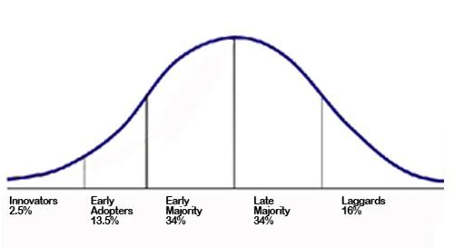
Shift of power: broker to agent Technology is the driving vehicle
Broker-centric
Agent-centric
1980s-1990s
Personal computers
Agents have more information access
1960s-1970s
Main frame computer
Broker has all the information

Slide 40
The next shift: agent to consumer???
Consumer-centric
Agent-centric
1980s-1990s
Personal computers
Agents have more information access
2000s – 2010s
Internet and mobile
Consumers have all the information

Slide 41
How do the venture capitalists see us?
What are the ramifications of having so much $$$ flowing into the real estate industry?
?
Notes:
After decades of coasting along relatively comfortably, the real estate industry is facing an onslaught of disruptors. It started with the listing portals – Zillow, Trulia and the others.
In the beginning, they were primarily lead generators (and lead sellers) and they stayed away from actual transactions.
Then, OpenDoor launched in 2014 and the industry began changing. This company and its imitators began “moving closer to the transaction … getting involved in more parts of” it, Michael DelPrete claims in an Inman Select video.
With Instant Offers, he says, Zillow began “moving from search engine to service engine.”
Today, there are several others in the iBuyer space, all clamoring for the holy grail of real estate: listings.

Slide 42
VC capital changing the rules of the game
Real estate tech financing trend
SOURCE: CB INSIGHTS

Slide 43
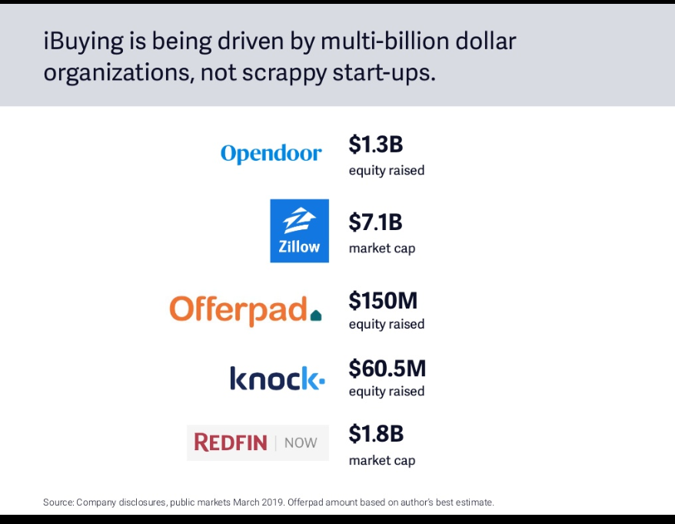

Slide 44
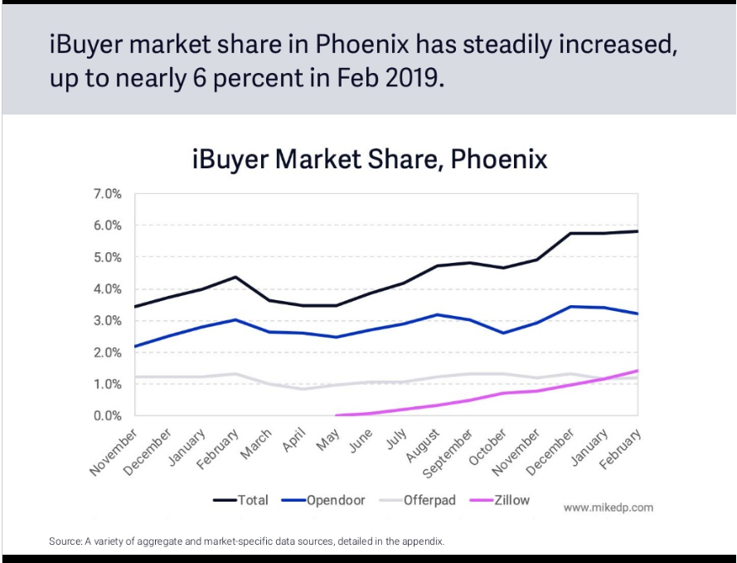
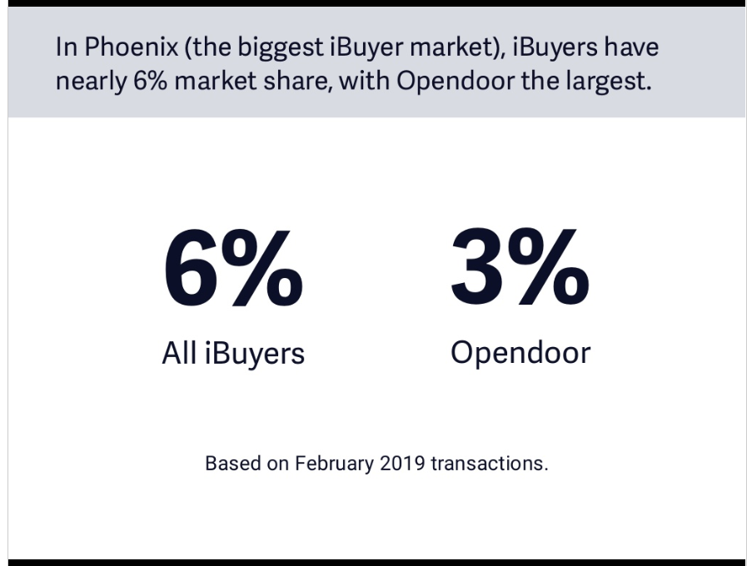
Growing Quickly

Slide 45
Impact of iBuyers on Residential Real Estate
“The iBuying Market could reach ~3% total transaction penetration by 2030, the equivalent of ~175k homes.” (Morgan Stanley)
iBuying Homes (000s)
% Total Homes
Source: Morgan Stanley Research

Slide 46
Where could this lead? iBuyer
is a viable alternative for those focused on convenience & certainty AND
sets a floor for home prices.
What beats a zestimate? A real offer from an iBuyer.

Slide 47
Majority of buyers and sellers used an agent
Up 5% from 2014
Up 9% from 2001
SERIES: 2018 REALTRENDS Consumer Survey
SOURCE: CALIFORNIA ASSOCIATION OF REALTORS®

Slide 48
Over half of buyers needed help with negotiating terms of sale and price
In which part of the transaction did you need the most assistance from your agent? (n=949)
SERIES: 2019 Consumer Survey
SOURCE: CALIFORNIA ASSOCIATION OF REALTORS®

Slide 49
Sellers needed assistance with a variety of things during the sale
With which part(s) of the sale did you need assistance from your agent?
(n=942)
SERIES: 2019 Consumer Survey
SOURCE: NATIONAL ASSOCIATION OF REALTORS®
Notes:
49

Slide 50
The process is far from easy…
+/-10 days
+/-20 days
loan process
loan condition removal
buyer
market education + view property
obtain necessary property inspections
inspections + conditions removal, increase deposit
move in
find agent
financial qualification
negotiation of terms
open escrow, deposit earnest money
loan funding,
title record at city hall,
utilities on/off
purchase offer presented to seller
accepted sales contract
disclosure, inspections
title search
closing procedures
+/-10 days
seller
market/
sales analysis by agent
establish price and list property
open houses and showings
provide property disclosures
facilitate property inspections
inspection and conditions removal
receive cash proceeds, rent back or move
multiple listing, advertising
+/-15 days
CALIFORNIA ASSOCIATION OF REALTORS®

Slide 51
23% had challenges in the closing process
Did you encounter any challenges in the closing process? (n=989)
SERIES: 2019 Consumer Survey
SOURCE: CALIFORNIA ASSOCIATION OF REALTORS®

Slide 52
Most still want to use an agent because of their professionalism
80% said they prefer to use a real estate agent because they are professional
80% said that buying or selling a home is a stressful process
73% said that the agent’s educational background was either extremely important, very important or important
47% agreed that the services provided by agents are less valuable now that the Internet has all housing information available
SERIES: 2018 REALTRENDS Consumer Survey
Source: CALIFORNIA ASSOCIATION OF REALTORS®

Slide 53
How to adapt? Embrace technology
It is not going away, whether you like it or not.
Understand it
Invest in it
Take advantage of it

Slide 54
True stars will be those who adapt, and they will dominate the future
There will be fewer agents overall
Fewer agents working part-time
Productivity will trend upwards
Professional sports analogy: stars prosper

Slide 55
The Industry will continue to evolve…

Slide 56
Where is the
local market data?

Slide 57
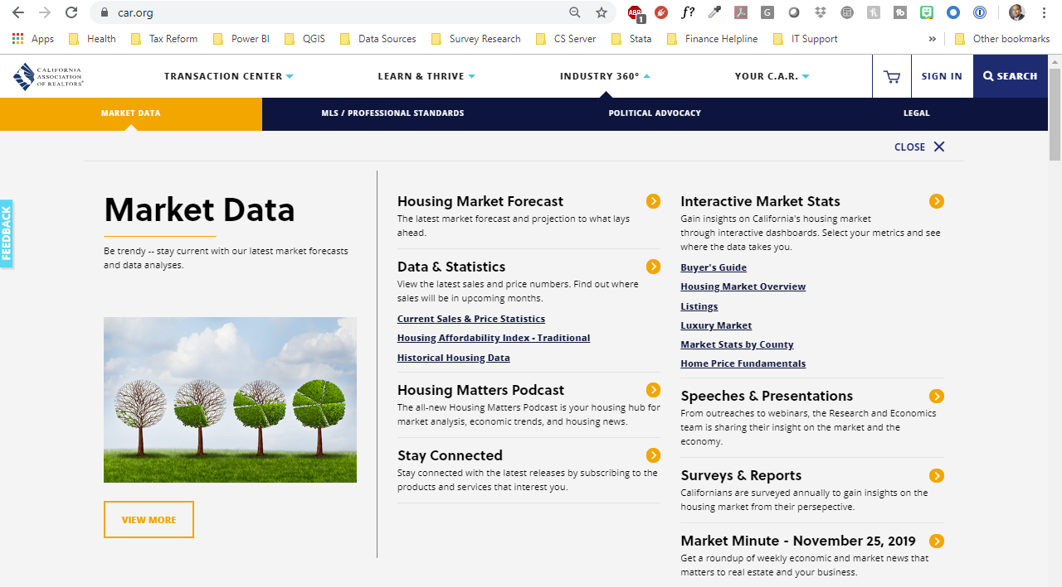
Where is the market data?

Slide 58
Thank You
This presentation can be found on
www.car.org/marketdata
Speeches & Presentations
joels@car.org

