Slide 1
CA Economic & Housing Market Update: Post COVID-19
Monterey County AOR
April 3, 2020
Leslie Appleton-Young
Chief Economist + SVP
California Association of REALTORS®

Slide 2
Nobody has any confidence at all about whether we are seeing the first phase of a new normal, the brief calm before a worse storm, or a wise reaction that may allow, not so horribly long from now, for a renewal of common life.
Adam Gopnik
The New Yorker 3/30/20

Slide 3
overview
01
02
Fundamentals First
Impacts of COVID-19
Still too early for most major indicators.
We started on a strong footing economically
Revised forecasts for economy and housing
Lots of uncertainty and forecasts change rapidly
03
04
Outlook & Scenarios
Resources for YOU
Rates won’t be enough to offset this one
Housing could be a bright spot after crisis
CAR has many resources available
Information & will connect you with ASSISTANCE

Slide 4
Review of
Pre-Crisis Economy

Slide 5
The economy was still growing at a decent clip

Slide 6
10 years into the longest economic expansion in history

Slide 7
Consumers have been driving economic growth 70% of GDP

Slide 8
Fastest job growth in a year

Slide 9
Unemployment: Was at an all-time low Feb: 3.5%

Slide 10
Most of CA was in single-digits

Slide 11
CA jobs continued to set new records as well

Slide 12
Consumers had been relatively confident

Slide 13
Consumer spending was powering the economy

Slide 14
Consumer debt flat, Mortgage debt declining

Slide 15
What’s Happening?

Slide 16
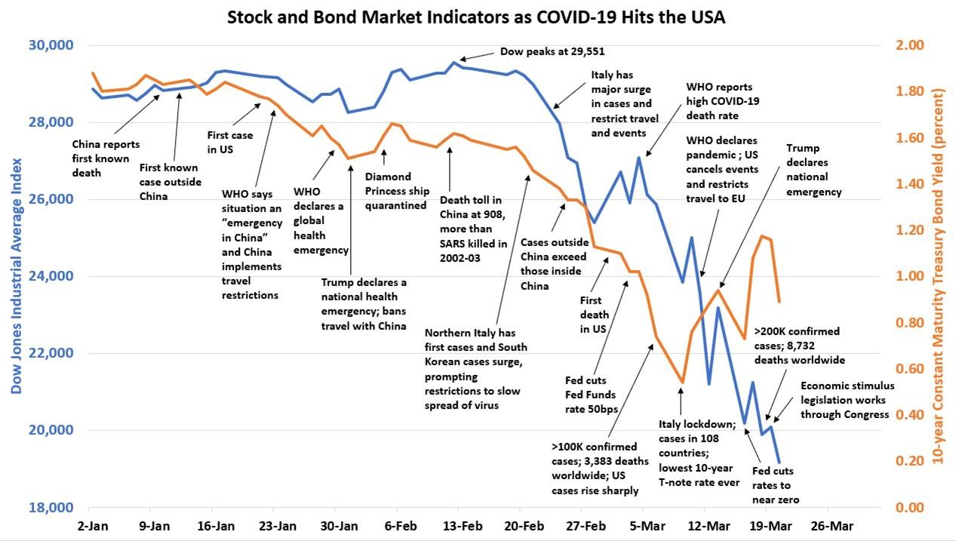

Slide 17
Equity markets were frothy and poised for issues
Notes:
High P/E ratio = investors expect higher earnings in the future
May mean the stock is over-valued
Companies that grow faster than average typically have higher P/E’s such as tech cpmpanies.

Slide 18
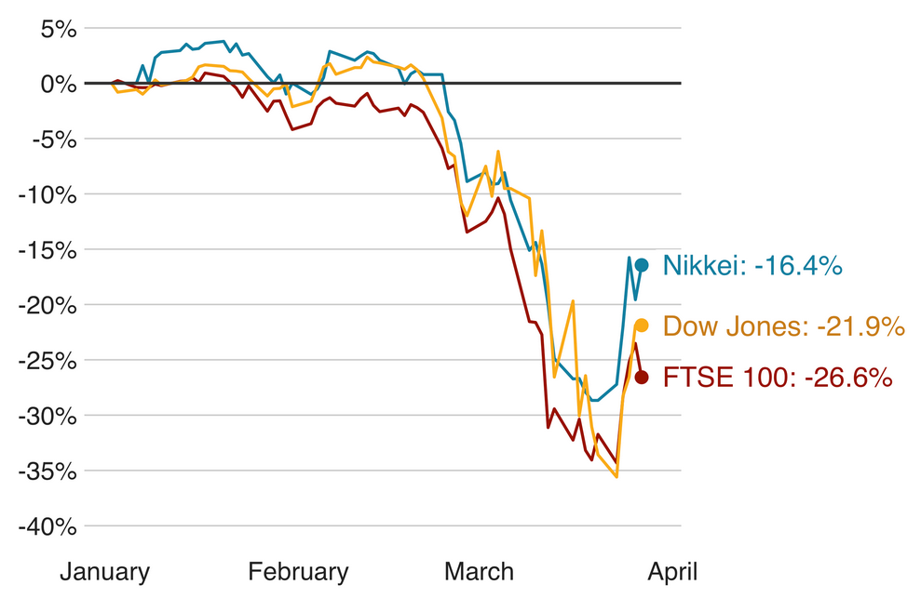
Financial markets impact people’s wealth & confidence
% chg. since start of year
SERIES: Dow 30, Nikkei, FTSE
SOURCE: Yahoo! Finance, Bloomberg
Notes:
https://finance.yahoo.com/quote/%5EDJI?p=^DJI

Slide 19
Federal Reserve has taken unprecedented action
Cut fed funds rate down to 0% - 0.25%
Lowered discount window rate to 0.25%
Expanded reverse repo operation, adding liquidity to the banking system by buying back short term securities
Restarted quantitative easing
Created multiple new programs to help preserve market liquidity
SOURCE: California Association of REALTORS®

Slide 20
Coronavirus Aid, Relief, and Economic Security Act CARES Act
Forgivable Small Business Administration Loans - independent contractors who take out SBA loans between 2/15/20 and 6/30/20 to cover payroll costs, mortgage interest, rents, and utility costs during the covered period may be forgiven.
Pandemic Unemployment Assistance – REALTORS® not eligible for unemployment insurance will be able to obtain unemployment assistance for up to 39 weeks if they were negatively impacted as a result of COVID-19
Direct Payments to REALTORS® – REALTORS® and their families with annual incomes of up to $75,000 will receive a rebate check of $1,200 ($2,400 for married couples with gross annual incomes up to $150,000). An additional $500 may be given per child in the household.
SOURCE: California Association of REALTORS®
Notes:
The CARES Act provides financial assistance in the form of Small Business Administration forgivable loans, Pandemic Unemployment Assistance payments, rebate checks, and payroll tax credits for employers who continue to pay employees while either fully or partially suspending operations due to the coronavirus.
Forgivable Small Business Administration Loans - Under the CARES Act, self-employed independent contractors may qualify for forgivable SBA loans. Under this program, borrowers who take out 7(a) SBA loans between Feb. 15, 2020, and June 30, 2020 to cover payroll costs, mortgage interest, rents, and utility costs during the covered period may be forgiven. C.A.R. urged Congress to include this provision; as independent contractors, REALTORS® do not have access to the safety net of unemployment benefits afforded to millions during this crisis.
Pandemic Unemployment Assistance – REALTORS® who are not otherwise eligible for unemployment insurance, such as independent contractors, will be able to obtain unemployment assistance for up to 39 weeks if they were negatively impacted as a result of COVID-19 between Jan. 27- Dec. 31, 2020.
Direct Payments to REALTORS® – Like many Americans, REALTORS® and their families with adjusted gross annual incomes of up to $75,000 will receive a rebate check of $1,200 ($2,400 for married couples with gross annual incomes up to $150,000). An additional $500 may be given per child in the household. This rebate amount decreases for incomes above those amounts and is completely phased out for individual incomes exceeding $99,000 ($198,000 married). These payments are expected to start going out in April.

Slide 21
Mortgage Rates are volatile & well above the usual 175 bp spread with the 10-Yr Treasury

Slide 22
Rates could eventually drop even lower

Slide 23
Why aren’t mortgage rates lower?
Shortage of short-term cash
Uncertainty over incoming wave of forbearance & payment deferments
Absence of demand for loans that don’t have low risk
Fed is buying mortgage bonds but they are not servicing mortgages. Investors want to be paid.

Slide 24
Wells Fargo Announcement 4/3/20
Will no longer buy jumbo mortgages on a correspondent basis
At least one other lender has followed suit
20% of the loans originated in CA are jumbo
Will negatively impact sales and prices
With forbearance & foreclosure restrictions these newly originated loans are likely underwater at origination
will have negative impacts on sales volumes and prices

Slide 25
Consumer confidence declined sharply in March
March 2020 120.0
SERIES: Consumer Confidence
SOURCE: The Conference Board
Notes:
Consumers were significantly less optimistic about the short-term outlook. The percentage of consumers expecting business conditions will improve over the next six months decreased from 20.6 percent to 18.2 percent, while those expecting business conditions will worsen increased from 7.2 percent to 14.9 percent.

Slide 26
If confidence is also impacted, not much to fall back on

Slide 27
Why This is So Serious

Slide 28
Unemployment claims suggest this is the tip of the iceberg

Slide 29
Unemployment rate lagging job losses February 3.5% March 4.4% Actual: 10% (est)

Slide 30
February already impacted as seen in retail figures

Slide 31
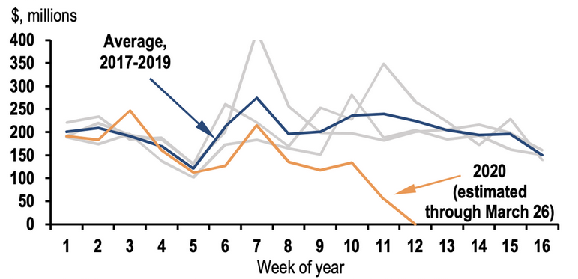
U.S. movie theaters struggle
Domestic movie theater box office receipts
*Greylines are data for 2017-2019
SOURCE: BoxOfficeMojo.com, J.P. Morgan
Notes:
https://markets.businessinsider.com/news/stocks/economic-outlook-charts-showing-coronavirus-movie-sports-dining-hotels-jpmorgan-2020-3-1029024298#us-movie-theaters-struggle1

Slide 32
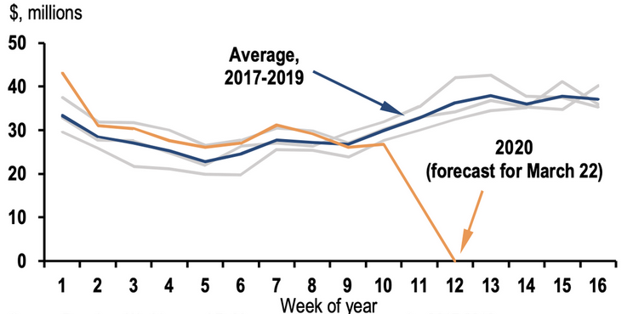
Broadway hits a new bottom
Broadway theater box office receipts
*Greylines are data for 2017-2019
SOURCE: BroadwayWorld.com, J.P. Morgan
Notes:
https://markets.businessinsider.com/news/stocks/economic-outlook-charts-showing-coronavirus-movie-sports-dining-hotels-jpmorgan-2020-3-1029024298#us-movie-theaters-struggle1

Slide 33
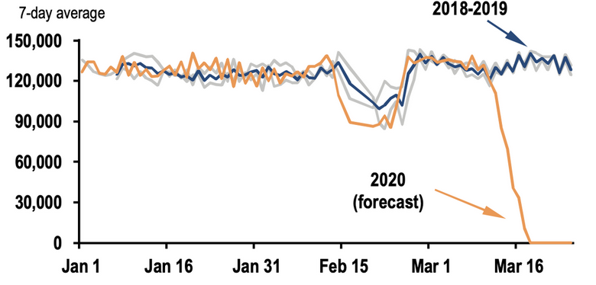
NBA attendance drops to zero
Attendance at NBA basketball games
(Average)
*Greylines are data for 2018-2019
SOURCE: espn.com, J.P. Morgan
Notes:
https://markets.businessinsider.com/news/stocks/economic-outlook-charts-showing-coronavirus-movie-sports-dining-hotels-jpmorgan-2020-3-1029024298#us-movie-theaters-struggle1

Slide 34
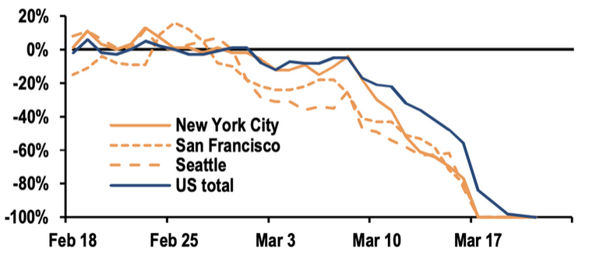
Restaurant bookings slide
Seated restaurant diners tracked by OpenTable.com
yty% chg.
SOURCE: OpenTable.com, J.P. Morgan
Notes:
https://markets.businessinsider.com/news/stocks/economic-outlook-charts-showing-coronavirus-movie-sports-dining-hotels-jpmorgan-2020-3-1029024298#us-movie-theaters-struggle1

Slide 35
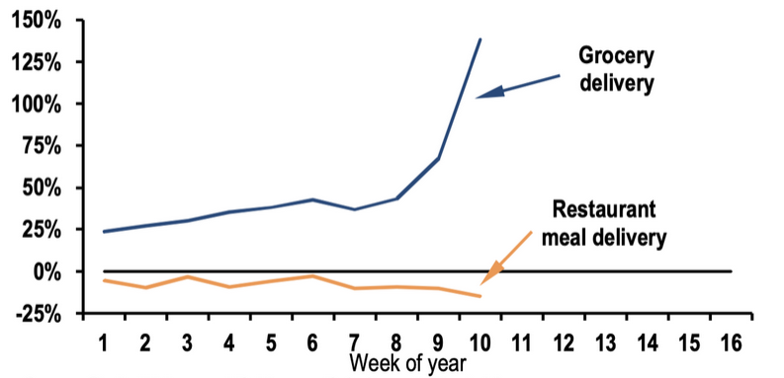
Grocery delivery surges but food delivery fails to increase
Website traffic growth over 2018-2019 average
*Data through March 14
SOURCE: SimilarWeb.com, J.P. Morgan
Notes:
https://markets.businessinsider.com/news/stocks/economic-outlook-charts-showing-coronavirus-movie-sports-dining-hotels-jpmorgan-2020-3-1029024298#us-movie-theaters-struggle1

Slide 36
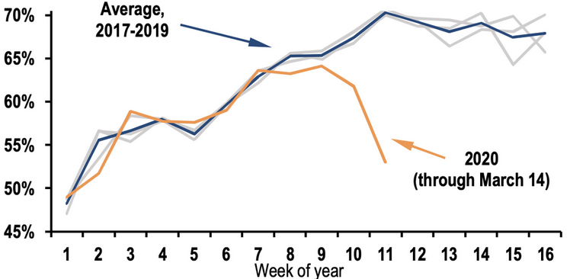
Hotel occupancy tumbles
U.S. hotel occupancy rate
*Greylines are data for 2018-2019
SOURCE: Smith Travel, J.P. Morgan
Notes:
https://markets.businessinsider.com/news/stocks/economic-outlook-charts-showing-coronavirus-movie-sports-dining-hotels-jpmorgan-2020-3-1029024298#us-movie-theaters-struggle1

Slide 37
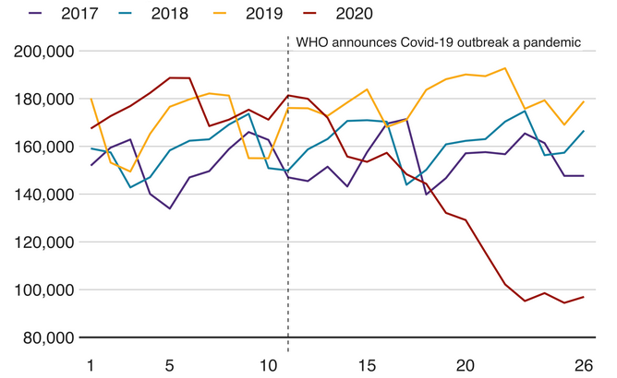
Fewer commercial flights
Number of daily flights in March
SOURCE: Flightradar24 (March 27, 2020), BBC
Notes:
https://www.bbc.com/news/business-51706225

Slide 38
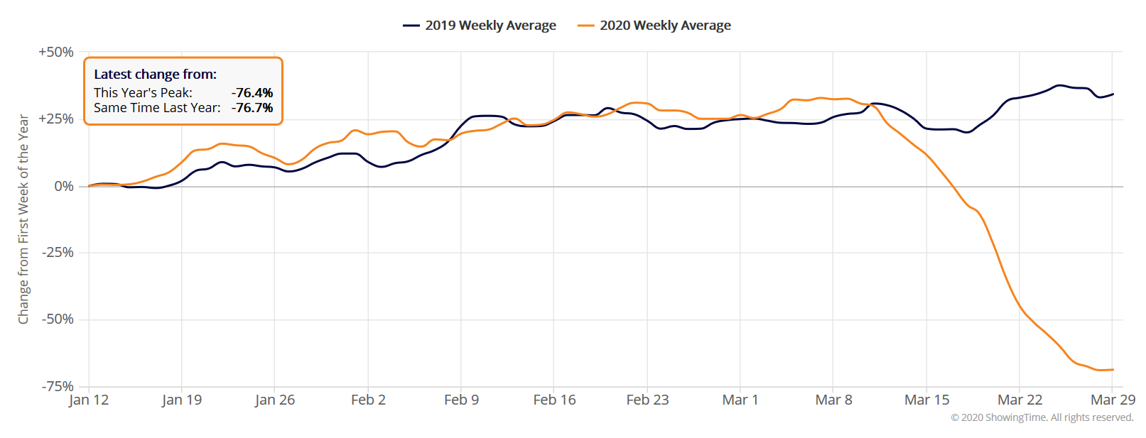
Showing activity dropped off significantly from last year
SERIES: Weekly showings normalized to the first calendar week of January, 7-day moving average
SOURCE: Showingtime.com,
Notes:
38
The data points represent a rolling weekly average in ShowingTime’s 100 top markets, with each market recording tens of thousands of appointments in 2019 and 2020.
ShowingTime is the leading market stats and showing management technology provider to the residential real estate industry.

Slide 39
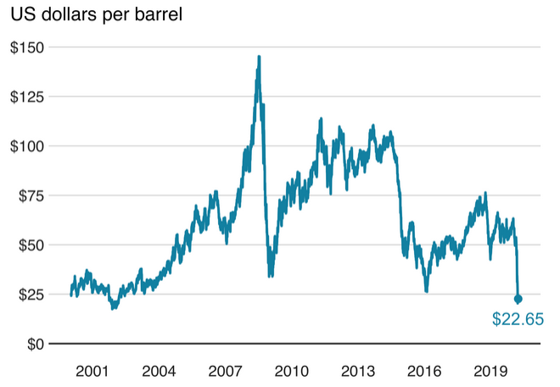
Oil hits record lows: Cheap fuel and no where to go
SOURCE: Bloomberg (as of March 27, 2020), BBC
Notes:
https://www.bbc.com/news/business-51706225

Slide 40
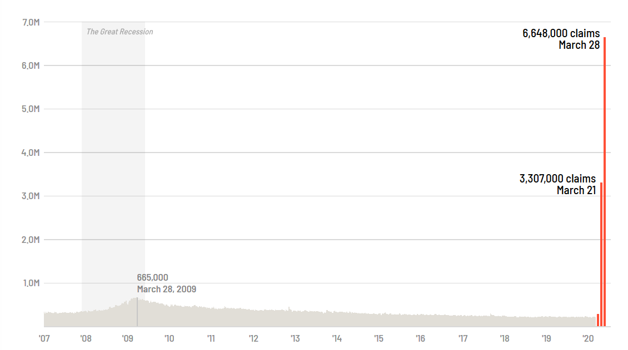
Unemployment claims: 10 million in two weeks
SOURCE: Dept. of Labor
Notes:
https://www.bbc.com/news/business-51706225

Slide 41
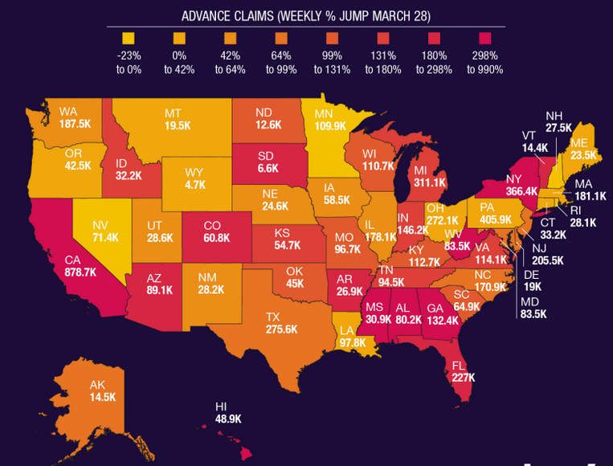
Unemployment claims by state
SOURCE: Dept. of Labor
Notes:
https://www.bbc.com/news/business-51706225

Slide 42
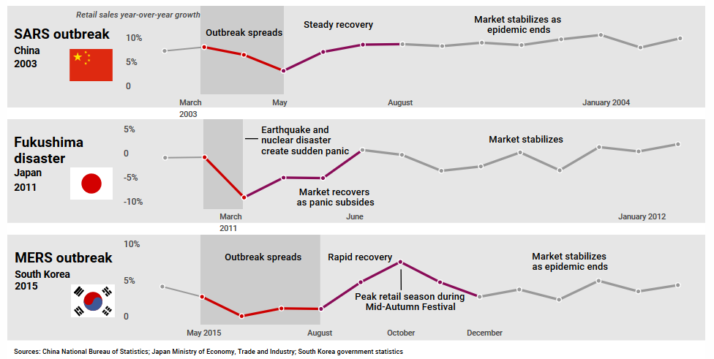
Retail markets dip during a crisis but stabilize eventually
SERIES: Retail sales year-over-year growth
Notes:
42

Slide 43
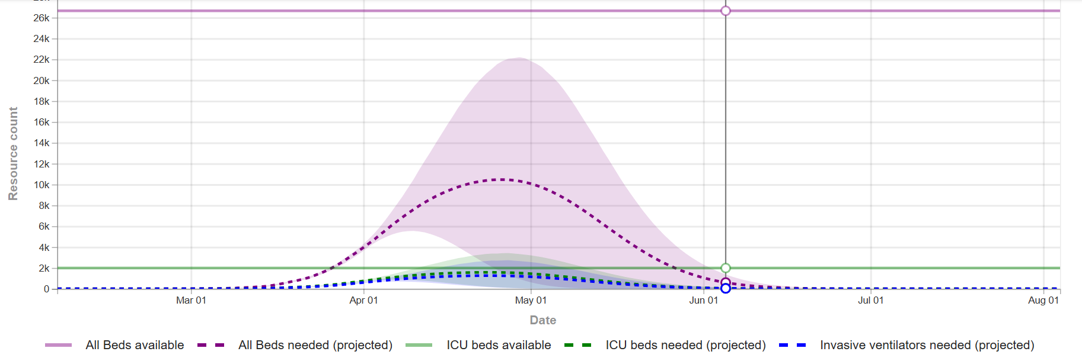
Timing is everything: when will we peak in California?
Note: The projections assume the continuation of strong social distancing measures and other protective measures.
SOURCE: Institute for Health Metrics and Evaluation (IHME)
Notes:
43

Slide 44
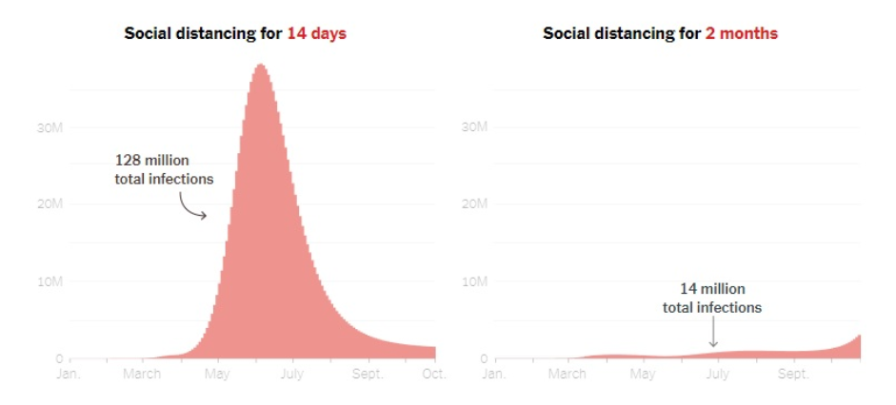
Rush to normalcy could increase the severity
SOURCE: New York Times
Notes:
44
Note: “Social distancing” also includes a reduction in large gatherings; some school closures and working from home; and efforts to support hospitals and diagnostic testing. Based on simulation between January and late October using an epidemic model.
https://www.marketwatch.com/story/reopen-america-by-easter-this-staggering-chart-shows-why-that-could-be-an-error-of-epic-proportions-2020-03-26?siteid=yhoof2&yptr=yahoo

Slide 45
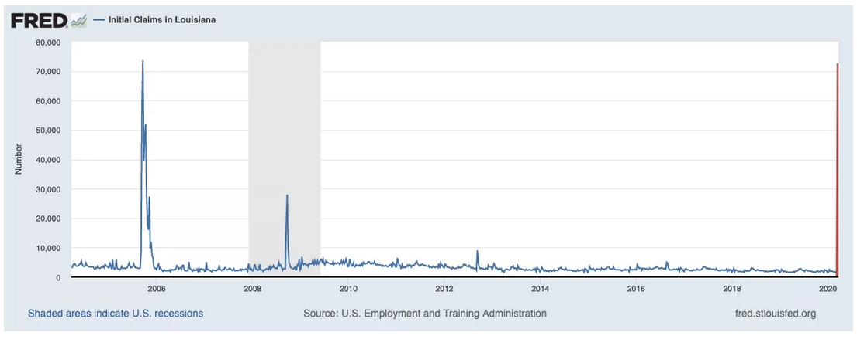
Jobs market: more like a natural disaster than recession
Jobless claims in Louisiana
SERIES: Louisiana jobless claims
SOURCE: St. Louis Fed, VOX
Notes:
45
In 2005, Louisiana was brutally affected by Hurricane Katrina and the subsequent bungled federal response. The hurricane physically destroyed many businesses and forced huge numbers of people to relocate; about 1.1 million people left Louisiana in the aftermath of the storm. As families struggled to recover, unemployment benefit claims shot up to record levels, hitting a peak of 73,702 for the week ending September 17, 2005. That’s far above the Great Recession peak for the state, reached on September 20, 2008, of 28,080 new claims, even accounting for lost population due to the hurricane.
But it’s not far above the jobless figures that Louisiana just posted: 72,620 new claims for the week ending March 21, 2020. The coronavirus crisis has taken a similar bite out of Louisiana’s job market as Katrina did at its peak.
https://www.vox.com/future-perfect/2020/3/30/21184401/coronavirus-covid-19-economy-charts

Slide 46
Concerns in Real Estate
Ramped Up Quickly

Slide 47
Dates
Week 1 (n=266): March 6-8
Week 2 (n=1,085): March 14-16
Week 3 (n=749): March 20-23
Week 4 (n=923): March 27-30
Notes:
Bay Area= Alameda, Contra Costa, Marin, Napa, San Francisco, San Mateo, Santa Clara, Solano, Sonoma
Southern California= Imperial, Los Angeles, Orange, Riverside, San Bernardino, San Diego

Slide 48
Members continue to feel the impact
Q: Do you feel that Coronavirus has or will have a negative impact on your personal Real Estate business?

Slide 49
Members continuing to report negative impact at higher rate each week
Q: Do you feel that Coronavirus has or will have a negative impact on each of the following?

Slide 50
9 in 10 have had clients hold back from buying
Q: Have you had any clients holding back from buying because of Coronavirus?

Slide 51
Increasing numbers of members are seeing buyers withdraw their offer
Q: Have you had any buyers withdraw an offer due to Coronavirus?

Slide 52
3/4 have had a seller hold back
Q: Have you had any clients holding back from selling because of Coronavirus?

Slide 53
Sellers continuing to remove homes from market
Q: Have you seen any sellers remove their home from the market completely due to Coronavirus?

Slide 54
More members reporting a transaction that fell out of escrow
Q: Have you had a transaction fall out of escrow due to Coronavirus?

Slide 55
How Are Agents
Coping With Change?

Slide 56
Nearly ½ now doing more virtual tours
Q: Have you been doing more virtual home tours due to Coronavirus?

Slide 57
Be the expert—especially on to loan funding issues
Q: If you have had a delay in a home closing due to Coronavirus, which of the following processes prevented you from closing on time?

Slide 58
52% of those who were supposed to close since March 15 did not
Q: Have you had any transactions close since March 15?
Median: 1 transaction closed
Notes:
*filtered to just respondents who were supposed to have a transaction close since march 15

Slide 59
Of those who have had a transaction close, 3 in 5 encountered difficulties
Q: Did you encounter any difficulties related to the COVID-19 environment?

Slide 60
Business interruption insurance/rainy day fund?
Q: Do you have business interruption insurance?

Slide 61
Market Environment Will
Remain Challenging During
“Shelter in Place” SIP

Slide 62
Monterey County: Closed sales still holding up

Slide 63
Monterey County: New listings have slowed

Slide 64
Monterey County: Pending sales shows most noticeable impact

Slide 65
Dates & Data Source
Week 1: March 1-7
Week 2: March 8-14
Week 3: March 15-20
Shelter-in-Place Order: March 16
Stay-at-Home Order: March 19
Data Source: 90+ multiple listing services/ local associations throughout the state

Slide 66
Closed sales started declining in most regions after SIP
Notes:
Closed sales include existing single-family homes only

Slide 67
Most experienced double-digit declines

Slide 68
New listings continue to decline since early March
Notes:
New listings include existing single-family homes only

Slide 69
Double-digit declines in new listings also common

Slide 70
Pending sales declined sharply in all regions
Notes:
Pending sales include existing single-family homes only

Slide 71
Sharp decline in pending suggest drop in closed sales soon

Slide 72
Real Estate Poised for
Strong, Eventual, Recovery

Slide 73
Sales highest in nearly 2 years
California, February 2020 Sales: 421,670 Units, 8.0% YTD, 5.9% YTY
SERIES: Sales of Existing Single Family Homes
SOURCE: CALIFORNIA ASSOCIATION OF REALTORS®
Notes:
*Sales are seasonally adjusted and annualized

Slide 74
Median price remained below 600k but grew solidly from last year
California, February 2020: $579,770, 0.8% MTM, 8.5% YTY
SERIES: Median Price of Existing Single Family Homes
SOURCE: CALIFORNIA ASSOCIATION OF REALTORS®

Slide 75
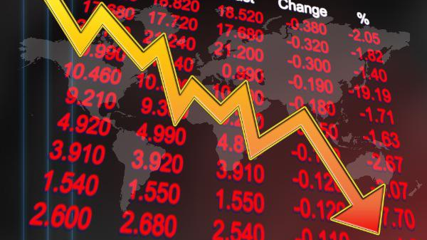
Market might make real estate look more attractive

Slide 76
The
Forecast

Slide 77
We are either already in a recession or entering one
 | Q120 | Q220 | Q320 | Q420 | 2020
Bank of America | -7.0% | -30.0% | -1.00% | 30.0% | -10.4%
Barclays | 0.5% | -7.0% | 0.0% | 2.5% | -0.6%
Goldman Sachs | -9.0% | -34.0% | 19.0% | NA | -6.2%
JP Morgan | -10.0% | -25.0% | 8.0% | 4.0% | NA
Morgan Stanley | -2.4% | -30.1% | 29.2% | 3.3% | -2.3%
Federal Reserve Bank of St. Louis | NA | -50% | NA | NA | NA
UBS | -2.1% | -9.5% | 2.1% | 6.7% | -0.9%
UCLA | 0.4% | -6.5% | -1.9% | 4.0% | -0.4%
Wells Fargo | 1.2% | -14.7% | -2.3% | 1.8% | -2.4%
page
77
Last update 4/3/20
Notes:
https://www.stlouisfed.org/on-the-economy/2020/march/bullard-expected-us-macroeconomic-performance-pandemic-adjustment-period

Slide 78
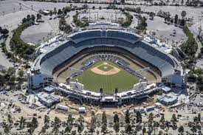
Opening Day 2020: Maybe there’s crying in baseball after all

Slide 79
Concluding remarks
Economy was in good shape prior to the outbreak
Coronavirus has changed everything for 2020
Unprecedented in terms of size and economic scope
Data still rolling in and weeks seem like months
Unemployment is and will drive negative impacts
Already seeing the effects on housing
Key question hinges on how long the SIP lasts
Severe pullback may be best chance for quick recovery

Slide 80
How C.A.R. is actively focused on helping members:
Federal Relief for REALTORS® as Independent Contractors
Real Estate as an Essential Service
New COVID-19 Forms for REALTORS®
Electronic Closings
Online Notary Services

Slide 81
COVID-19 Resources for Members
COVID Relief Hotline (213) 351-8450
Coronavirus Microsite car.org/coronavirus
Coronavirus Weekly Newsletter from news@car.org
Legal Hotline (213) 739-8282
Legal Webinars car.org/riskmanagement/live
Transaction Rescue™ Hotline (213) 739-8383

Slide 83
Thank You
This presentation can be found on
www.car.org/marketdata
Speeches & Presentations
lesliea@car.org

