Slide 1
California Housing
Market Update
Monterey County Association of REALTORS®
June 24, 2021
Jordan G. Levine
VP & Chief Economist
California Association of REALTORS®

Slide 2
Overview
01
02
Rearview Very Encouraging
Low Visibility Ahead
Lot to be optimistic about economically
Housing has still led the recovery up to now
Some very early signs of new listings popping up?
Fatigue highlights need to get serious on supply
03
04
Things Going TOO Good?
The Forecast
Price growth was largely explained. Now?
What is our exposure and what is the risk?
Forecast still optimistic, but expect downshift
Supply/demand will respond & cool price growth
Hopefully…

Slide 3
Market Recap:
The Good News

Slide 4
Daily California COVID-19 trends are encouraging
39.8M Doses
57.3% received 1st shot

Slide 5
Close correlation between health numbers and jobs

Slide 6
A perfect storm for housing demand
Current: 2.93%
High income earners insulated
<10% of jobs lost were high wage
Home more important than ever
Need for more space (~120sq. ft.)
More job flexibility/less commuting
Permanent remote work for some
And let’s not forget…

Slide 7
Share of first-time buyers highest in 10 years…
Record low interest rates have been fueling the market and many first-time buyers took advantage of cheaper costs of borrowing during this year’s home buying season. The share of first-time buyers reached the highest level in ten years this past summer, with nearly two of five homes being sold to buyers who purchased for the first time. This year’s spike could also be attributed to the fact that fewer homeowners (i.e. repeat buyers) have been putting their house up on the market and moving during the pandemic.
Q. Was the buyer a first-time buyer?

Slide 8
California housing market remains robust in May
May 2021
445,660
Existing Home Sales
% change
+86.7% YTY
+34.6% YTD
Price
$818,260
+39.1% Y2Y
Unsold Inventory Index
1.8 months
-58.1% Y2Y
Median Days on Market
7 days
-58.8% Y2Y
CALIFORNIA ASSOCIATION OF REALTORS®

Slide 9
Sales growing across the state, but especially along coast

Slide 10
Don’t give up on cities—homebuyers haven’t!
Region | May-21 Index Value
Bay Area | 160.06
Central Coast | 134.77
Far North | 128.60
Southern California | 125.71
Central Valley | 121.03

Slide 11
Some of the price growth is expensive homes
SERIES: Percent Change in Sales
SOURCE: CALIFORNIA ASSOCIATION OF REALTORS®

Slide 13
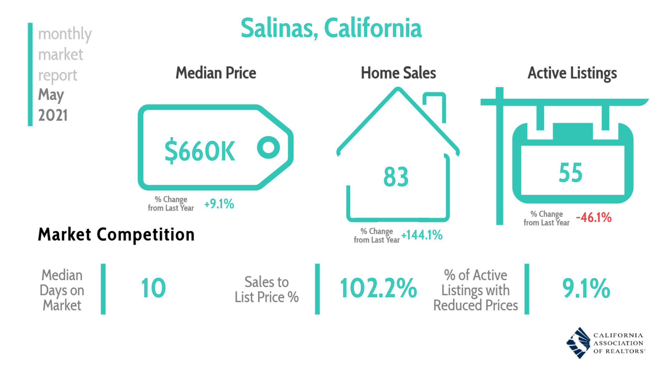

Slide 15
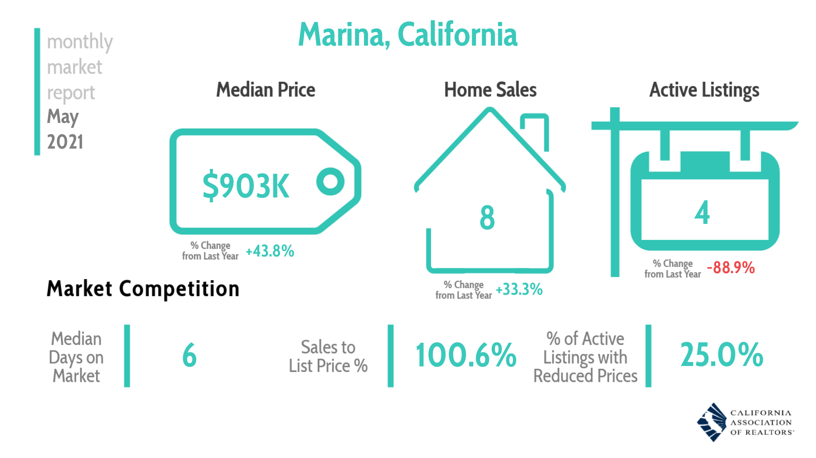

Slide 18
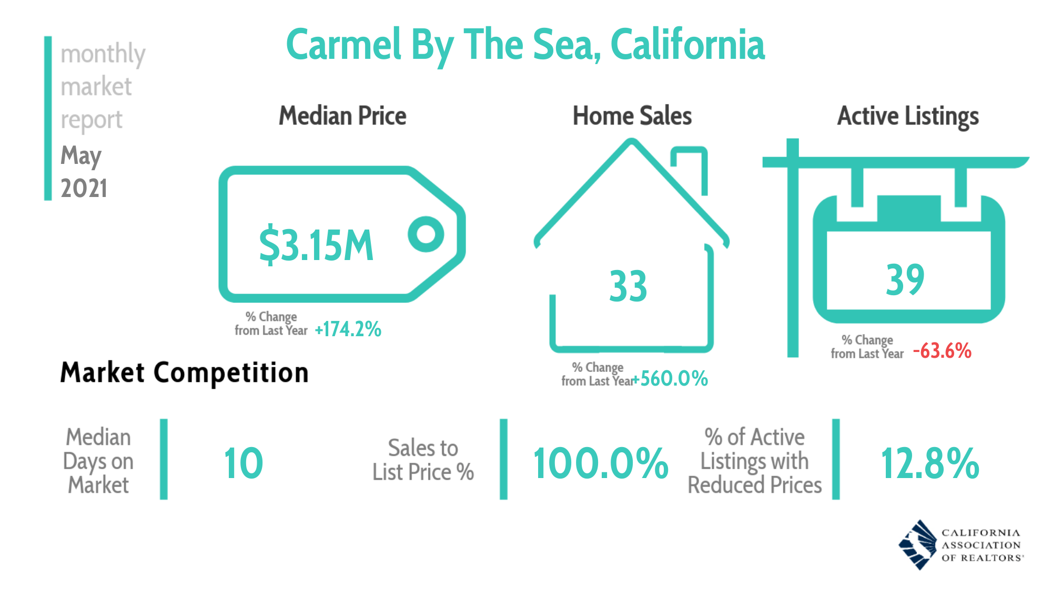

Slide 19
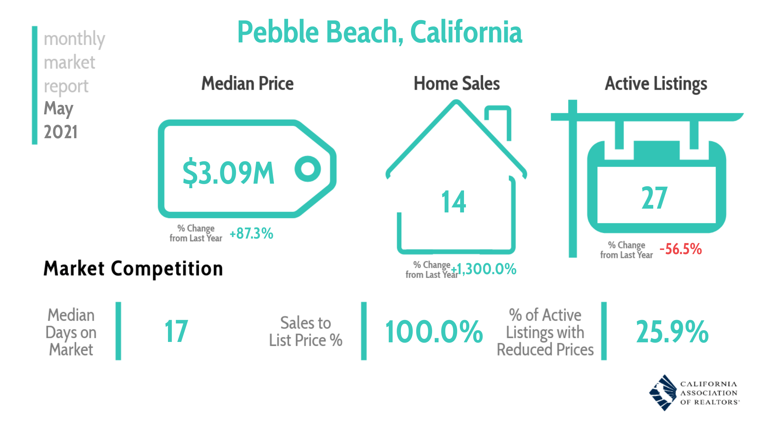

Slide 20
Mix of sales changed rapidly in the past year
COVID-19
Outbreak
SERIES: Sales by Price Range
SOURCE: CALIFORNIA ASSOCIATION OF REALTORS®

Slide 21
California sets new record high
California, May 2021: $818,260, +0.5% MTM, +39.1% YTY
SERIES: Median Price of Existing Single Family Homes
SOURCE: CALIFORNIA ASSOCIATION OF REALTORS®

Slide 22
Time on market at the lowest level ever recorded
California, May 2020: 18.0 Days; May 2021: 7.0 Days
SERIES: Median Time of Market of Existing Single Family Homes
SOURCE: CALIFORNIA ASSOCIATION OF REALTORS®

Slide 23
Sales price-to-list price ratio climbed further
May 2021: 103.8%, +0.6% MTM, +4.2% YTY
SERIES: Sales to List Ratio of Existing Single Family Homes
SOURCE: CALIFORNIA ASSOCIATION OF REALTORS®

Slide 24
Seven out of ten homes sold above asking price
SERIES: Sales with sold price above asking price (Existing SFH)
SOURCE: CALIFORNIA ASSOCIATION OF REALTORS®

Slide 25
A Few
Red Flags

Slide 26
Biggest gap between buyers and sellers ever
SERIES: Google Consumer Poll
SOURCE: CALIFORNIA ASSOCIATION OF REALTORS®
Notes:
%yes
September 2018-January 2020 n=300
February 2020 and beyond n=1,000
Feb-21 n=947

Slide 27
Concrete signs of buyer fatigue setting in?

Slide 28
Sales lose momentum even as growth rate spikes
California, May 2021 Sales: 445,660 Units, +34.6% YTD, +86.7% YTY, -2.7% MTM
SERIES: Sales of Existing Single Family Homes
SOURCE: CALIFORNIA ASSOCIATION OF REALTORS®
Notes:
*Sales are seasonally adjusted and annualized

Slide 29
Interpret big weekly growth rates with caution

Slide 30
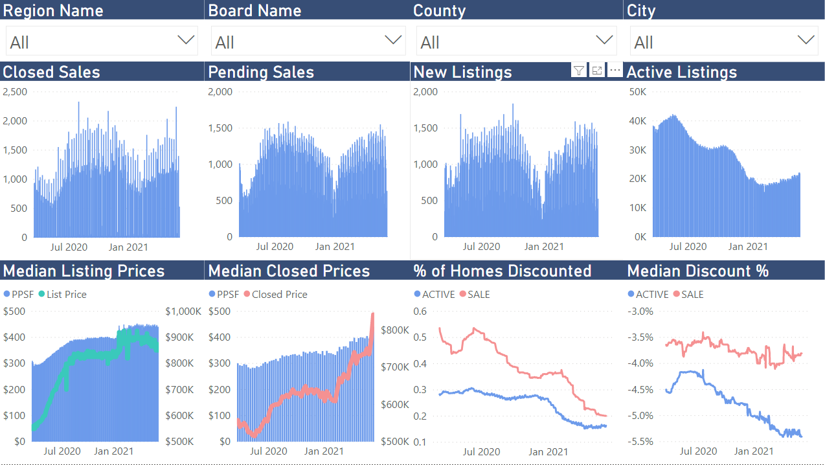

Slide 31
New listings up, BUT well-below pre-pandemic
New Listings (Existing Single-Family Homes)
SERIES: New Listings (Existing Single-Family Homes)
SOURCE: CALIFORNIA ASSOCIATION OF REALTORS®

Slide 32
Were Prices Overheated?
A Q4-2020 Analysis

Slide 33
California has had steady inflation over that time

Slide 34
Home prices have risen tremendously…

Slide 35
Real payments only recently above historical norms

Slide 36
More inequality, but prices weren’t particularly overblown

Slide 37
Where SHOULD
Prices Have Been?

Slide 38
More inequality, but prices aren’t particularly overblown

Slide 39
Potential for price declines, but not 2006 all over again

Slide 40
Prices Up Another
$100K Since Then

Slide 41
Strongest price growth ever recorded!
California, May 2021: $818,260, +0.5% MTM, +39.1% YTY
SERIES: Median Price of Existing Single Family Homes
SOURCE: CALIFORNIA ASSOCIATION OF REALTORS®

Slide 42
Rates help some, but payments still up 30%+
SERIES: Price Growth vs. Mortgage Payment Growth
SOURCE: CALIFORNIA ASSOCIATION OF REALTORS®

Slide 43
Even assuming 10% income growth, risk has increased

Slide 44
BUT… Less Potential
For Snowballing

Slide 45
Not as many fundamental problems in mortgage market

Slide 46
Many homeowners still had skin in the game

Slide 47
Delinquency already improving despite slower recovery

Slide 49
Most forbearance exits pose minimal foreclosure risk
66%

Slide 50
Less potential for REOs with equity, help, and 30yr FRMs

Slide 51
Even assuming 10% income growth, risk has increased

Slide 52
Cashing in on home equity ramping up!

Slide 53
Structural Issues
More Pressing Now

Slide 54
Affordability deteriorating even with lower rates
California: 2006-2021
SERIES: Housing Affordability Index of Traditional Buyers
SOURCE: CALIFORNIA ASSOCIATION OF REALTORS®
Notes:
C.A.R. began producing its Housing Affordability Index (HAI) in 1984. At that time, fixed-rate mortgages were the prevailing form of financing a home purchase, while the calculations used to produce the HAI reflected a 20 percent down payment. The methodology also assumed a monthly payment for principal, interest, taxes and insurance that was no more than 30 percent of a household’s income. In the more than two decades since the CALIFORNIA ASSOCIATION OF REALTORS® first conceived the HAI, the mortgage finance landscape has changed dramatically. The range of mortgage products available to buyers as well as underwriting criteria has changed. C.A.R. developed the new index measuring affordability for first-time home buyers to better reflect the realities of today’s real estate market.

Slide 55
Where will rates end up settling?

Slide 56
Should we be optimistic about supply?

Slide 57
California’s dubious record on housing affordability
2nd worst Jobs-to-Construction ratio in nation.
The 5th lowest homeowner vacancy rate in the nation.
3rd lowest rental vacancy rate in the nation.
Record low 1.3 months of housing inventory in December.
~$820,000 record-setting median price in May.
2nd worst state for % of rent-burdened households.
2nd worst state for overcrowded housing.
Dead last for supplemental poverty estimates.

Slide 58
The need for housing is MORE urgent than ever
19%
Q. How was the property occupied?
SERIES: 2020 Housing Market Survey
SOURCE: CALIFORNIA ASSOCIATION OF REALTORS®

Slide 59
Optimistic
NOT Overconfident

Slide 60
California housing market outlook
 | 2015 | 2016 | 2017 | 2018 | 2019 | 2020 | 2021f
SFH Resales (000s) | 409.4 | 417.7 | 424.9 | 402.6 | 398.0 | 411.9 | 458.0
% Change | 7.0% | 2.0% | 1.7% | -5.2% | -1.2% | 3.5% | 11.2%
Median Price ($000s) | $476.3 | $502.3 | $537.9 | $569.5 | $592.4 | $659.4 | $712.1
% Change | 6.6% | 5.4% | 7.1% | 5.9% | 4.0% | 11.3% | 8.0%
Housing Affordability Index | 31% | 31% | 29% | 28% | 31% | 32% | 27%
30-Yr FRM | 3.9% | 3.6% | 4.0% | 4.5% | 3.9% | 3.1% | 3.0%
page
60
SERIES: CA Housing Market Outlook
SOURCE: CALIFORNIA ASSOCIATION OF REALTORS®

Slide 61
Concluding remarks
Housing market still doing unseasonably well
Some of this is exaggerated by last year
Headwinds are starting to crop up for buyers
Keeping it really real
Increased risk as price growth is getting more frothy
No longer explained by the basic fundamentals
Really exacerbates our structural issues, creating urgency
Putting it all together
Less potential for snowball effects, but not immune
Magnitude of worst-case correction much smaller
Need Econ 101 to kick in for sustainable growth

Slide 62
Thank You
This presentation can be found on
www.car.org/marketdata
Speeches & Presentations
jordanl@car.org

