Slide 1
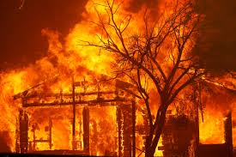
Wildfire Safety MCAR Presentation
Gaudenz Panholzer
Fire Chief
July 28, 2022

Slide 2
Wildfire Preparedness
Home Hardening
Defensible Space

Slide 3
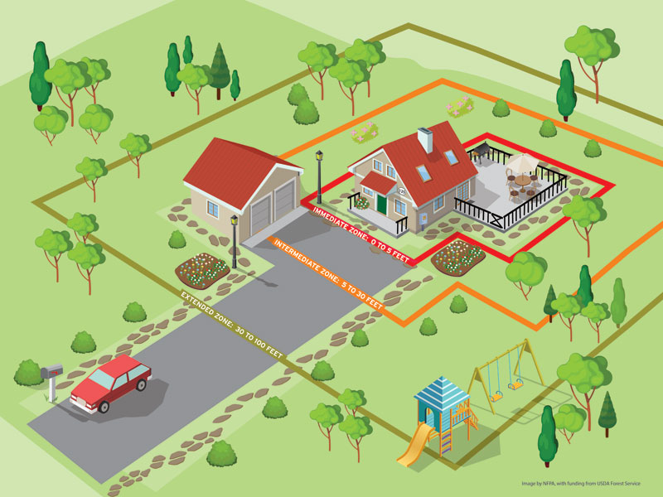
Wildfire Preparedness
Home hardening
Defensible space

Slide 4
Defensible Space
Harden Home

Slide 5
Home Hardening
Use fire-resistive roofing and siding
Install a spark arrester on all chimneys
Cover all vent openings with 1/8th inch (max) mesh screen
Use fire-resistive materials for decks and fences
Install dual-pane windows with tempered glass
Use shutters or blinds in place of drapes
Box in eaves

Slide 6
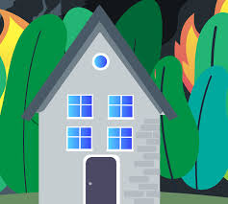
Home Hardening
Close in spaces under low decks
Remove vegetation and items that could catch fire from around and under decks, balconies and stairs
Remove dead or dry leaves and pine needles from your roof and rain gutters
Remove branches that hang over your roof and keep dead branches 10 feet away from your chimney
Make sure your address is visible from road

Slide 7
Defensible Space
Immediate Zone: 0’-5’
Ember Resistant

Slide 8
Immediate Zone Ember-Resistant Zone
Currently not required by law
Science has proven it to be the most important
Use hardscape like gravel, paver, concrete, etc.
Remove dead dying weeds
Only low-growing, nonwoody, maintained plants
Limit combustible items
Replace combustible fencing and gates

Slide 9
Defensible Space
Intermediate Zone: 5’-30’
Lean, Clean, and Green

Slide 10
Intermediate Zone Lean, Clean, & Green Zone
Extends out 30 feet from buildings, structures, decks
Remove all dead plants, grass and weeds (vegetation)
Remove dead or dry leaves and pine needles from your yard
Trim trees regularly to keep branches a minimum of 10 feet from other trees and 6 feet above the ground
Relocate wood piles to Extended Zone

Slide 11
Defensible Space
Extended Zone: 30’-100’
Reduce Fuel

Slide 12
Extended Zone Reduce Fuel Zone
Extends 30-100 feet from buildings, structures, decks
Mow annual grass down to a max height of 4 inches
Create horizontal space between shrubs and trees
Create vertical space between grass, shrubs and trees
Keep fallen leaves, needles, twigs, bark, cones, and small branches to a depth of 3 inches

Slide 13
Defensible Space
All mitigation efforts stop at your property line

Slide 14
Assembly Bill 38

Slide 15
What is AB38?
Assembly Bill 38 established that, as of July 1, 2021, California Civil Code Section 1102.19 requires a seller of real property located in a High or Very High Fire Hazard Severity Zone to provide the buyer with documentation stating the property is in compliance with defensible space requirements.

Slide 16
What is AB38?
The law allows, that if documentation demonstrating compliance cannot be obtained by the close of escrow, the seller and buyer can enter into a written agreement showing that the buyer agrees to obtain documentation of compliance within one year of the close of escrow.

Slide 17
Fire Hazard Severity Zone (FHSZ)
California is divided into fire service areas:
LRA – Local Responsibility Area
SRA – State Responsibility Area
FRA – Federal Responsibility Area
All of SRA has designated FHSZs
Many local jurisdictions have adopted FHSZs for LRA
FHSZ can be found at:
https://egis.fire.ca.gov/FHSZ/

Slide 19
Defensible Space Regulations
Public Resources Code Section 4291 requires maintaining a defensible space in SRA
100 feet from each side and from the front and rear of the structure
Not beyond the property line
Many local agencies have adopted similar regulations in LRA

Slide 20
Defensible Space Inspections
Many jurisdictions conduct annual Defensible Space Inspections
Assist homeowners in keeping their properties safe

Slide 21
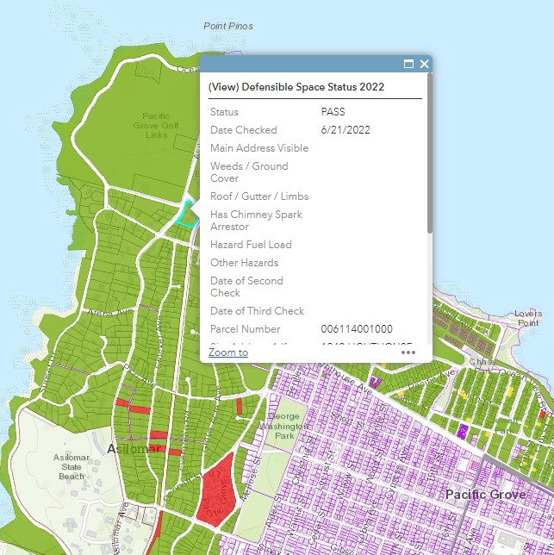
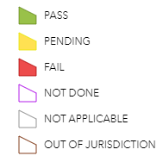
Monterey Fire DSI Program
Public access to info at: www.monterey.org/fire
Legend

Slide 22
Required Inspections
AB38 required inspections can be requested via fire agency having jurisdiction
Go to: https://www.fire.ca.gov/dspace
Click on link found on left side of page
Self-inspection survey on above web site

Slide 24
DSI Request Form
Complete online form
You will receive a confirmation email
Appropriate local inspector will complete an inspection and provide you with results
Some agencies may charge a fee for this service

Slide 25
Enforcement
No viable enforcement mechanism exists
May create liability risk for
Seller / Buyer
Agent / Broker (both sides)
May cause issues with financing and/or insurance
Compliance with Defensible Space requirements may result in insurance premium reduction

Slide 26
Questions

