Slide 1
HOW TO ACCURATELY DISCLOSE ON THE FHDS Form with JCP Account Manager Julie Lynn

Slide 2
What is new in the JCP Report Now in the C.A.R. Drop Down Menu NEW - Consolidated Signature Page SB 63 – New Layers in the LRA SGMA – Coming Soon C.A.R Form FHDS – Revised June 2022

Slide 3
SB 63 What You Need To Know
Only a Very High fire hazard severity zone currently exists in the LRA.
Steer clear of unofficial “Draft” maps. Relying on unapproved maps creates unnecessary liability.
The new fire zones will expand the reach of Assembly Bill 38’s home-hardening and defensible space requirements. They do not replace it.
Our report will include these new severity levels only after they are officially issued by the State Fire Marshal – until then, we will state “Map Not Available.”
You can view the California Department of Forestry and Fire Protection (CAL FIRE) official maps & fire severity zones through their online public viewer https://egis.fire.ca.gov/FHSZ/
Disclosures.com | 800.748.5233

Slide 4
AB 38 Facts
Official CalFire Map: 2007, Used to Determine AB 38 & Trigger FHDS
Only CalFire’s High or Very High (Not Moderate)
Local City and County Maps do not trigger AB 38 unless adopted by ordinance as the Very High FHSZ
Local Maps determine Building Codes & Local Ordinances - MARIN
SRA & LRA is on the Signature Page of NHD Report – See attached
AB 38 & SB 63 Are Found in the Summary of the JCP Report
CalFire Does NOT require all seller’s have an inspection prior to COE

Slide 5
AB 38 Best Practices
Listing Agents:
Is property in a High or Very High FHSZ in the Summary of the JCP Report, Yes = FHDS Form
Is Home built prior to 2010 – Seller Fills out Home Hardening Questions
Has Seller had a Defensible Space Inspection in last six months, If yes include in Disclosures
Is it Mandatory for seller to have an inspection prior to COE? Only if there is a local POS Ordinance
Is there a Local POS Ordinance? Call the City, Not determined by Fire Departments
Who does Seller contact for an inspection? JCP tells you in our Report
IF Fire Agency does not or can’t do an inspection: Document who, when, how, i.e., phone or email
Buyers Agent:
Check NHD AND FHDS Form, Is your Buyer Agreeing in writing to comply with AB 38 1 yr after COE
Who do they call for an inspection: JCP tells you in the Report.
NO TDS = No AB 38
These are recommendations only, please consult your broker or legal counsel for legal advice.

Slide 7
AB 38

Slide 8
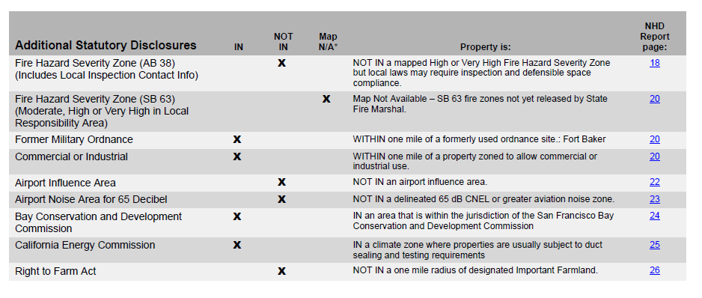

Slide 9
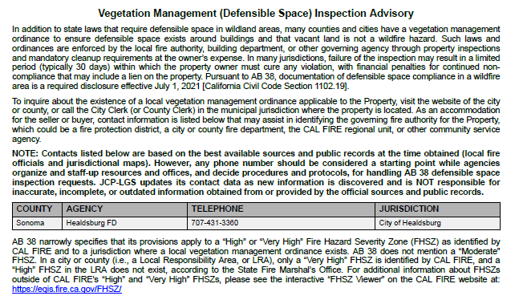

Slide 10
Local Ordinances: For the past 45 years First American and its NHD predecessor, JCP, have maintained a policy of not disclosing city or county ordinances, why?
there are over 500 county and city jurisdictions in California and each one has legislated dozens to hundreds of local ordinances
disclosing all of those ordinances in a natural hazard disclosure report would distract from the critical statutory disclosures that are truly mandated in a real estate transaction
arbitrarily deciding that one ordinance is more important than all others and should be included in an NHD report creates potential liability for the company and its customers for errors and omissions -- for failing to disclose an ordinance that another customer’s lawyer arbitrarily decides is more important
we defend our company and its customers from non-disclosure liability by setting limits around the non-required disclosures that we do include
those limits are embodied in our long-standing policy to require a written request from the local real estate board to include a non-required disclosure in our report as an addendum within that board’s service area only -- that written request transfers the liability for that decision to the local board and protects the company and its customers whom the decision may affect

Slide 11
JCP-LGS Always Compliant Always Up To Date
Julie Lynn
Account Manager
Santa Cruz, Monterey and San Benito Counties

